Slide 1
Speaking the Language of Hospital Administrators
Tracy P. Young MSNA, MBA, CRNA

Slide 2
Objectives
Identify common terms associated with hospital business communications
Discuss the value of personal relationships with hospital administrators
Describe key terms in negotiating contracts with hospital administrators

Slide 3
Speaking the Language of Hospital Administrators
Financial Terminology
Billing Terminology
Contract Terms
Key Performance Metrics
(Benchmarking)
Quality Data Reporting and Efficiency Modeling

Slide 4
Speaking the Language of Hospital Administrators
Financial Terminology in Anesthesia Business:
Revenue
Gross Charges vs Collections
Expenses
Cost of Goods Sold (Provider Salaries, typically 80+% of anesthesia expenses)
Billing Expenses
Overhead
Malpractice
Net Profit (Margin)

Slide 5
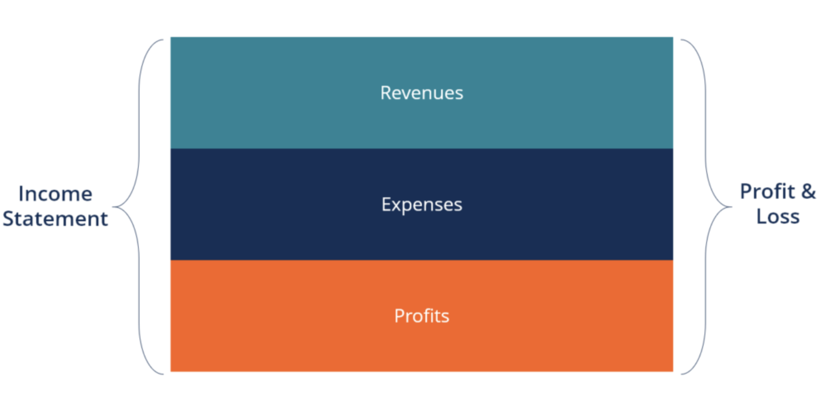
Pro Forma
Pro forma, a Latin term, literally means “for the sake of form” or “as a matter of form.” In the world of business, pro forma refers to a method by which future financial results are predicted based on future assumptions. This method of calculation places emphasis on present or projected figures.
In its most basic form, all expected expenses and cost are added up and all forms of expected revenues are totaled, and the difference is either your expected profit or loss.

Slide 6
Financial Statements
There are four main types of financial statements:
Statement of Financial Position (AKA Balance Sheet)
A static snapshot of Assets, Liabilities and Equity
2. Income Statement (AKA Profit and Loss Statement)
A look back at a period of time showing the income, expenses and profit or loss for that period of time.
Cash Flow Statement
Presents the movement of cash and balances over a period by segments (operations, investing, financing)
4. Statement of Changes in Equity (AKA Retained Earning Report)
Derived from the P&L and shows changes in equity over a defined period.

Slide 7
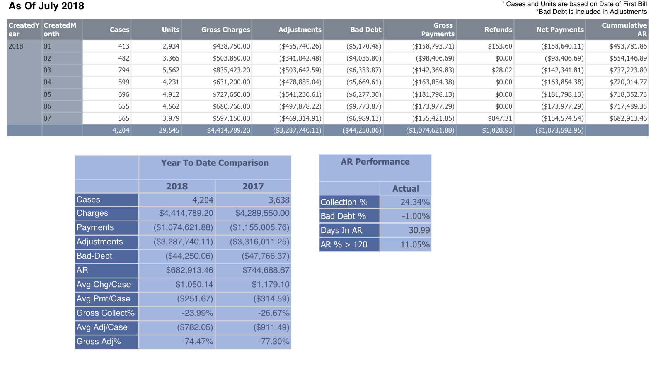
Speaking the Language of Hospital Administrators
Billing Terminology:
Billed Charges vs Collections
Percent Collected
Conversion Factors vs Allowable
EOBs
AR Reporting
Average Days in AR
Denial Reports
Payment Variance Reports
Clean Claims Rate

Slide 8
Billing Reports

Slide 9
Billing Reports

Slide 10
Billing Reports

Slide 11
Speaking the Language of Hospital Administrators
Contract Terminology:
Exclusivity
Termination Clauses
Auto Renew Clauses
Fee for Service
Subsidy- Fixed vs Net of Collections
Non-Solicit and No Hire Clauses

Slide 12
Speaking the Language of Hospital Administrators
Key Performance Measures for Potential at Risk Compensation:
Quality Measures
Adverse Events
Antibiotic Administration
Efficiency Measures
On-Time Starts
Turnover Time
Patient Satisfaction
Surgeon Satisfaction

Slide 13
Speaking the Language of Hospital Administrators Types of Contracts
There are three main types of Anesthesia Contracts
Straight Fee for Service
Fee for Service with a Subsidy (fixed or floating)
Management Contract

Slide 14
Types of Contracts Straight Fee for Service
Pros
Shared risk between Anesthesia and Facility
Stability since your service is not costing the facility anything
Motivated to increase surgical volume and efficiency
Cons
Shared Risk, no guarantee that you will be profitable
Market conditions change
Reimbursement reductions
Changes in Medicare rules and regs

Slide 15
Types of Contracts Fee for Service w Subsidy
In this model, the anesthesia group performs just like in the fee for service, but the facility makes up for any potential losses with a subsidy payment to the anesthesia group.
Subsidies can come in many different shapes and sizes. Call stipend, income guarantee, medical directorships etc. Bottom line is that the facility is subsidizing the anesthesia department.
The subsidy is typically either floating or fixed.
Floating stipends vary with the collections on the fee for service side. This is also called a “Net of Collections” model
Fixed stipends are regular payments made in the same amount to an anesthesia group to subsidize the department.

Slide 16
Types of Contracts Fee for Service w Subsidy
Pros
Minimum Anesthesia revenue is guaranteed, zero loss if pro forma was accurate
Not dependent on the hospital/surgical volume to makes ends meet
Reimbursement changes don’t have direct affect on bottom line
Cons
Hospital on hook to meet your cost
They may question your ability or desire to maximize income through collections
They are reminded monthly that they are subsidizing anesthesia and thus have to remind them regularly of the value you bring to the facility
Profit margins are potentially smaller

Slide 17
Types Of Contracts Management Contract
An Anesthesia Services Management contract can take on many forms. As the name implies, the Anesthesia company is contracted to manage an anesthesia service. Often the management company provides back end support such as billing, recruiting, vacation relief etc for a management fee.
A recent trend has been for physician owned centers to see anesthesia as another service line that they can own and profit from but do not want manage.
This is more common in Surgery Centers and Endoscopy Centers
There could be some regulatory and legal concerns with some of these arrangements (Stark Law, AKS, Physician Self Referral, State Medical Practice Acts etc)

Slide 18
From Language to Relationship Building
Once you learn the language, everything else becomes relationships.

Slide 19
Building Relationships That Last
Hospital administrators move and change jobs frequently.
Always value and preserve the relationship even when things are going poorly.
Build a professional/business relationship first.
Develop a personal/professional relationship over time.

Slide 20
Key Components of the Relationship
Trust
Honest Answers ( Even when it isn’t pleasant).
Understanding the position of administration and searching for the middle ground.
Give praise, positive comments, pats on the back in public

Slide 21
From Relationships to Negotiation
The Art of Negotiating and how to find a win/win scenario.

Slide 22
The Art of Negotiation
What is negotiation?
Any activity that influences another person
A basic means of getting what you want
A process by which we deal with our differences
Ideally, Negotiation:
Avoids “zero sum” outcomes
Involves side-by-side problem solving with a resulting “win-win” for the parties
Produces a wise agreement, efficiently and amicably

Slide 23
The Art of Negotiation
Notes:
It is a zero-sum game in which one person's gains always come at the expense of another. Haggling over the price of a used car is another example of a distributive negotiation – for every dollar advantage you gain by getting the price lowered, the dealer loses by receiving one dollar less.
A win-win negotiation is a careful exploration of both your own position, and that of your opposite number, in order to find a mutually acceptable outcome that gives you both as much of what you want as possible

Slide 24
The Art of Negotiation

Slide 25
The Art of Negotiation
Because we tend to listen autobiographically, we tend to respond in one of four ways:
Evaluating
You judge and then either agree or disagree
Probing
You ask questions from your own frame of reference
Advising
You give counsel, advice and solutions to problems
Interpreting
You analyze others’ motives and behaviors based on your own experience

Slide 26
The Art of Negotiation
Separate PEOPLE from the problem
Focus on INTERESTS not positions
Invent OPTIONS for mutual gain
Insist on objective CRITERIA

Slide 27
The Art of Negotiation
Synergize
When people begin to interact together genuinely, and they're open to each other's influence, they begin to gain new insight. The capability of inventing new approaches is increased exponentially because of differences.

Slide 28
Questions and Answers
Thank You!

