Slide 1
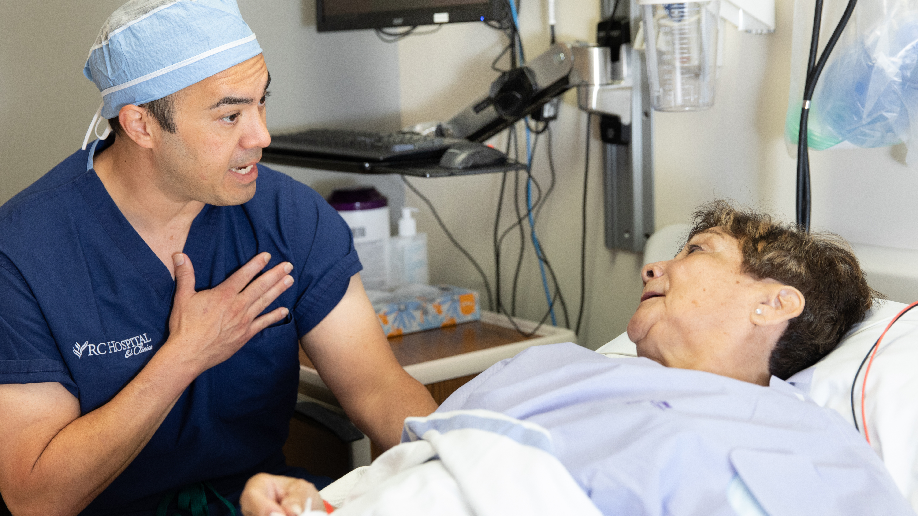
Ketamine: What’s Old is New Again
Tracy Young, MSNA, MBA, CRNA
Copyright 2020. Tracy Young. All Rights Reserved.
Notes:
Arial Version – Universally usable

Slide 2
Conflict of Interest Disclosure Statement
AANA Annual Conference 2020
Tracy P. Young MSNA, MBA, CRNA
I have the following financial relationships to disclose:
I am a Partner in Neuromend Infusion Center, LLC.
I will discuss the following off-label use during my presentation:
Ketamine infusion for non-anesthetic use

Slide 3
Objectives
Identify the history of Ketamine
Discuss the abuse potential for Ketamine
Describe the mechanism of action of Ketamine
Discuss common and alternative uses of Ketamine
Identify studies looking at alternative Ketamine use
Discuss protocols for Ketamine infusion therapy

Slide 4
What is Ketamine?
In 1823, Lord Byron wrote in canto 14 of his poem Don Juan “'Tis strange—but true; for truth is always strange; stranger than fiction.”
Ketamine is a phencyclidine (PCP) derivative
Classified as an anesthetic and is a schedule III drug in the US
Depending on dosage, produces a Trance-Like state, pain relief, sedation and memory loss
Also widely used in veterinary medicine

Slide 5
Chemical Compound of Ketamine

Slide 6
The History of Ketamine
First synthesized in 1962 by American Scientist Calvin Stevens¹.
Originally named Cl-581 and was intended as an anesthesia drug
Derived as a derivative of PCP which was first synthesized in 1926.
Ketamine was intended to replace PCP because PCP caused prolonged and severe hallucinations and psychotic symptoms

Slide 7
The History of Ketamine
First clinical use was in Belgium in 1963 as a veterinary anesthetic.
First Human testing was in 1964 where it was found to have a shorter duration and less hallucinogenic side effects than PCP
First known recreational use of Ketamine was in 1965 by noted Professor Edward Domino who noted potent psychedelic effects and coined the term “Dissociative Anesthetic”.

Slide 8
Story of Early Ketamine Abuse
Dr. Domino published an intriguing tale about the early days of Ketamine in “Anesthesiology: The Journal of the American Society of Anesthesiologist” in 2010 named “Taming the Ketamine Tiger”.
One such story involved Marcia Moore, a yoga instructor, and Dr. Howard Alltounian, a respected clinical Anesthesiologist, and how they met through self administration of Ketamine in 1978.¹
Anesthesiology 9 2010, Vol.113, 678-684. doi:10.1097/ALN.0b013e3181ed09a2

Slide 9
The Ketamine Tiger

Slide 10
Ketamine Addiction
Ketamine—also referred to as Special K, Kit Kat, cat valium, Dorothy or Vitamin K—is an anesthetic for humans and animals that is abused as a recreational drug. It is especially popular in the club scene among young adults.
Ketamine is a Schedule III Controlled Substance, the same category as codeine and anabolic steroids. Schedule III substances can lead to physical dependence but are very likely to lead to psychological dependence.
Ketamine has a short-lived high and tolerance to the drug builds up quickly, requiring user to keep increasing quantities as they chase the initial high.
Ketamine is produced as a liquid, which can be injected; as a white or off-white powder, which is snorted by abusers; or as a pill. It has been used as a date rape drug because it is odorless and colorless and is not detected by the victim in a beverage, often rendering its victim completely helpless.

Slide 11
Current Ketamine Abuse
https://www.justice.gov/archive/ndic/pubs4/4769/

Slide 12
Mechanism of Action of Ketamine
The focus of all modern drug development has been on specificity and affinity. Scientist strive to isolate compounds that interact specifically with targeted receptors and have a high degree of binding to the target receptors.
This produces “Clean” drugs that produce consistent actions and limited adverse reactions or side effects that could occur from multiple receptor stimulation.

Slide 13
Mechanism of Action of Ketamine
Known actions of ketamine include:
Non-competitive antagonist of the NMDA receptor (NMDAR)
Negative allosteric modulator of the nACh receptor
Weak agonist of the μ-opioid and κ-opioid receptors (10- and 20-fold less affinity relative to NMDAR, respectively), and very weak agonist of the δ-opioid receptor
Agonist of the D₂ receptor
Weak mACh receptor antagonist (10- to 20-fold less affinity relative to NMDAR)
Inhibitor of the reuptake of serotonin, dopamine, and norepinephrine
Voltage-gated sodium channel and L-type calcium channel blocker, and HCN1 channel blocker
Inhibitor of nitric oxide synthase
σ receptor 1 and 2 agonist (μM affinities).
Activation of AMPA receptors (producing Glutamate surge)

Slide 14
Mechanism of Action of Ketamine
Anti-Depressant Mechanism of Action:
Scientist think they have isolated the series of reactions that produces ketamine’s rapid relieve of refractory depression in the majority of test subjects.
The activation of AMPA receptors which is part of the glutamate receptor complex is now thought by some scientist to be the mechanism of action that rapidly relieves patients of severe refractory depression.^{2,3}

Slide 15
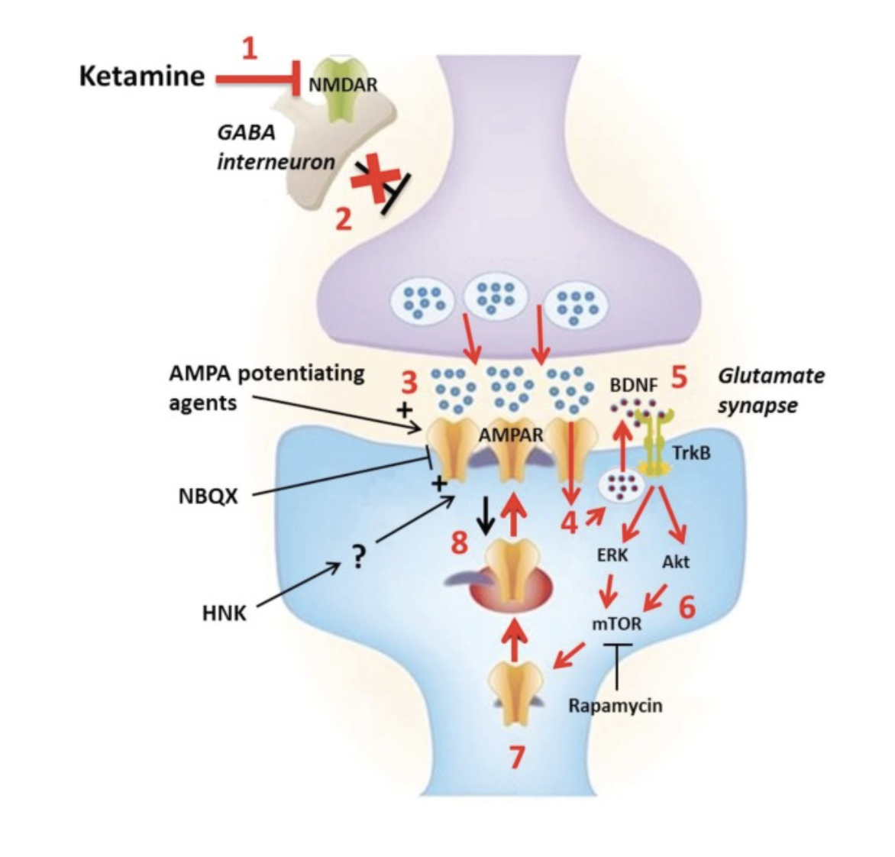
Ketamine Mechanism of Action on Depression
https://www.ncbi.nlm.nih.gov/pmc/articles/PMC5487269/

Slide 16
Ketamine Mechanism of Action for Depression
Synaptic and intracellular processes activated by the rapid-acting antidepressant ketamine. Preliminary preclinical and unpublished clinical data suggest that postsynaptic NMDA receptor antagonism increases presynaptic glutamate release (i.e., glutamate “surge”). Glutamate is then hypothesized to increase AMPA/NMDA receptor flux. AMPA channel opening in the CNS increases sodium and, indirectly, calcium, stimulating the PI3K cascade
In sum, the translational activation induced by acute NMDA receptor blockade increases the expression of several neuromodulatory proteins involved in, among other effects, postsynaptic scaffolding, neurotransmitter dynamics, and dendritic spine morphogenesis from synaptically unstable filopodia to synaptically dynamic mushroom-shaped spines (see previous image), which form the morphological substrate for antidepressant-like behavioral effects. ^{2,3}

Slide 17
Ketamine Mechanism of Action for Depression
While glutamate surge is still considered the primary mechanism of action in relieving depression, new studies have looked at how or why glutamate and ketamine is effective.
Scientist in China are looking at a region of the brain called the lateral habenula (LHb) which acts as the dark twin of the pleasure centers of the brain.
In depressed rats, the LHb was hyperactive and often sent burst signals to the rest of the brain. After an injection of ketamine into the LHb reduced the amount of burst signals being sent.⁴

Slide 18
Ketamine Effect on CNS
The NMDAR antagonism is responsible for the anesthetic, amnestic, dissociative, and hallucinogenic effects of Ketamine.
NMDAR antagonism is also responsible for some of the analgesic properties of Ketamine by preventing central sensitization in the dorsal horn neurons, thus preventing the transmission of pain signals through the spinal cord.
Ketamine also inhibits the synthesis of nitric oxide synthase which lowers the production of nitric oxide which is a neurotransmitter involved in pain perception.
The action of Ketamine at sigma and mu opioid receptors is relatively weak but also aids in the analgesic properties

Slide 19
Ketamine Effects on the PNS
Ketamine also has catecholaminergic effects by inhibiting the reuptake of serotonin, dopamine and nor-epinephrine.
Cardiovascular effects are often an increase in BP, increase in HR and increased Cardiac Output.
Gastrointestinal effects of serotonin reuptake inhibition is thought to cause the N&V seen in higher doses
Respiratory effects are lack of respiratory depression, increased salivation and potential bronchodilator effects secondary to catecholamine elevation.

Slide 20
Pharmacokinetics of Ketamine
Ketamine is absorbable IV, IM, Oral and Topically due to its water and lipid solubility.
It is commercially prepared for IV, IM and intranasal use. Less commonly used orally due to bioavailability of only around 20% due to first pass effect
Peak plasma concentrations are reached in 1 minute IV, 5-15 Minutes IM, 30 minutes PO
Intranasal administration associated with rapid onset and increased bioavailability over PO.

Slide 21
Pharmacokinetics of Ketamine
Biological Half-Life
2.5-3 Hours
Duration of Action IV/IM
Typically less than 1 Hour IV
Up to 2 Hours for IM Administration
Metabolized
Primarily by the Liver
Has Several Active Less Potent Metabolites
Excreted
90% by the Kidneys

Slide 22
Pharmacokinetics of Ketamine
Despite the “Dirty” non-specific nature of Ketamine, it has a wide margin of safety; several instances of unintentional administration of overdoses of ketamine (up to ten times that usually required) have been followed by prolonged but complete recovery.
Ketamine has been studied in over 12,000 operative and diagnostic procedures, involving over 10,000 patients from 105 separate studies. In these studies' ketamine hydrochloride was administered as the sole agent, as induction for other general agents, or to supplement low-potency agents.⁵

Slide 23
Results
In these studies, the anesthesia was rated either "excellent" or "good" by the anesthesia provider and the surgeon at 90% and 93%, respectively; rated "fair" at 6% and 4%, respectively; and rated "poor" at 4% and 3%, respectively. In a second method of evaluation, the anesthesia was rated "adequate" in at least 90% and "inadequate" in 10% or less of the procedures.⁵

Slide 24
Future of Ketamine
Currently ketamine is seeing a bit of a renaissance in anesthesia as more providers are exploring its usefulness in low doses and in combination with other anesthetics and anxiolytics.
Also, Ketamine is seeing wide use in non-anesthesia treatments. While I think it would be a mistake to consider ketamine a panacea in mental health, promising Studies are being done examining the effects of ketamine on depression, suicidal ideations, drug dependence and abuse, PTSD and chronic regional pain syndrome. ⁶

Slide 25
Ketamine for Depression
Depression is the third leading cause of disability in the world. Depressive symptoms may be reduced within several weeks after the start of conventional antidepressants, but treatment resistance concerns one-third of patients who fail to achieve recovery.
Multiple small studies have shown immediate and profound alleviation of depression symptoms in up to 75% of patients that have been refractory to conventional anti-depressants.
The NIMH is conducting large scale studies with sites across the US.
Most studies used a low and slow method of infusion (0.5-1mg/kg infusion over an hour) with 6 infusions over an initial 2-week period.
Length of anti-depressant results varied but majority of patients went 2 months or greater before booster infusion needed.⁷

Slide 26
Ketamine for Depression
Findings from one meta analysis by Han et al in Neuropsychiatric Treatment and Disease Journal in 2016 that looked at 9 high quality studies with 368 patients found:
Conclusion
“These results indicated that ketamine could yield a good efficacy in the rapid treatment of MDD. Future large-scale clinical studies are needed to confirm our results and investigate the mid- and long-term efficacy of ketamine in treating MDD.” ⁸

Slide 27
Ketamine for PTSD
The first evidence from a randomized clinical trial that the anesthetic agent ketamine may provide rapid symptom reduction in patients with chronic posttraumatic stress disorder (PTSD) when delivered intravenously was been published in 2014.
In it, researchers led by Adriana Feder, MD, found that intravenous (IV) infusion of ketamine hydrochloride (0.5 mg/kg) was associated with significant and rapid reduction of PTSD symptom severity compared with an active control agent. ⁹
Study was small and is considered a proof of concept study only at this point.
Ketamine clinic in San Antonio area treating large amount of military PTSD patients with reportedly great results.

Slide 28
Ketamine for Suicidal Patients in the ED
Suicidal ideation is an emergent problem in the Emergency Department (ED) that often complicates patient disposition and discharge. It has been shown that ketamine possesses fast acting antidepressant and anti-suicidal effects.
A recent literature review of 24 studies and articles found that ketamine was efficacious in treating acute suicidality and the decrease in suicidal ideation was independent of improvements in mood. ¹⁰
Low dose IV Ketamine often can be an effective immediate short-term treatment for Emergency Room patients with suicidal ideations. (as an aid to help patients to enter into long term conventional treatment regimens)

Slide 29
Ketamine for Migraines
Studies:
Dr. Carlos Zarate, a Chief researcher at the National Institute of Mental Health, says that “we can take care of a migraine in hours” using ketamine.
Dr. Zarate is mainly focused on using Ketamine for treating major depressive disorders, however, there have been several studies geared toward treating Migraines.
One study tested the effects of intranasal Ketamine on 11 patients with familial hemiplegic migraines. Under supervision, each participant was given a 25 mg dose via a nasal spray at the onset of a Migraine attack. They were asked to record their symptoms 15 minutes after each use and were then allowed to administer Ketamine at home. During the study, over half of the participants reported an improvement of all their symptoms after using Ketamine. ¹¹

Slide 30
Ketamine for Migraines
In a separate study, researchers examined the effects of IV Ketamine infusions of participants who were actively having a Migraine attack. Over 159 minutes, participants were given 64 mg of Ketamine through an IV.
On a 1-10 pain scale, participants had an average pain score of 6 before treatment. After the Ketamine infusion, the average pain score reduced to 2.5.

Slide 31
Ketamine for Migraines
The most promising study was performed by the late Dr. Andrew Sewell on a Ketamine web forum.
247 patients participated in an open outpatient study that used IV infusions of Ketamine. The participants represented five different types of Migraine sufferers. Every group reported at least a 50% reduction in their headaches.
In 162 patients with Refractory Migraines, 150 reported greater than 50% reduction in their pain.
In 39 patients with Chronic Migraine, 26 reported greater than 50% reduction in their pain.
In 4 patients with Paroxysmal Hemicrania, all 4 reported complete resolution of their pain for an average of 7 days.
In 11 patients with Cluster Headaches, all 11 reported complete resolution of their pain for an average of 6 days.
In 31 patients with non-specific headache type and facial pain, 25 patients reported greater than 50% reduction in their pain. ¹²

Slide 32
Ketamine for Chronic Regional Pain Syndrome
Besides anesthesia implications, Ketamine for CRPS is probably the most studied use of Ketamine:
Dose, length and frequency of infusions varied greatly from study to study
Some studies used much higher doses and inpatient setting, and some were outpatient with much lower doses
Majority of the studies have shown a significant reduction in pain scores for up to ten days post infusion ¹³

Slide 33
Ketamine for CRPS
Complex Regional Pain Syndrome:
Six studies focused exclusively on the use of ketamine infusions for the treatment of CRPS.
The majority of these articles report pain relief of several weeks after an infusion in an inpatient setting over 4 to 5 days.
However, outpatient infusion protocols requiring multiple serial infusions also reported pain relief lasting several months in some cases.
Although the general trend when all studies are considered is that longer durations provide increased duration of pain relief, there may be an optimal infusion duration of several hours beyond which no benefit is derived but the potential for side effects increases. ¹³

Slide 34
Ketamine for Fibromyalgia
Fibromyalgia:
Three studies focused on the use of ketamine infusions for the treatment of fibromyalgia.
All 3 studies utilized a relatively low dose of ketamine between 0.3 and 0.5 mg/kg administered over 10 to 30 minutes.
No study reported benefits beyond the first few hours after the infusion. It is not certain whether this is because of a lack of responsiveness of fibromyalgia pain to ketamine infusions or whether a higher dose is required to produce longer lasting analgesia.
The changes in pain scores after the infusion in 2 studies are encouraging and suggest that further optimization of dose and duration may provide some degree of relief. ^{13 (images below as well)}

Slide 35
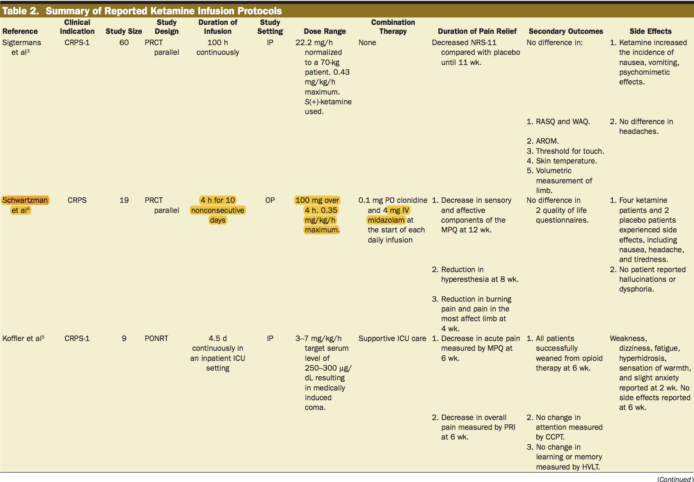

Slide 36
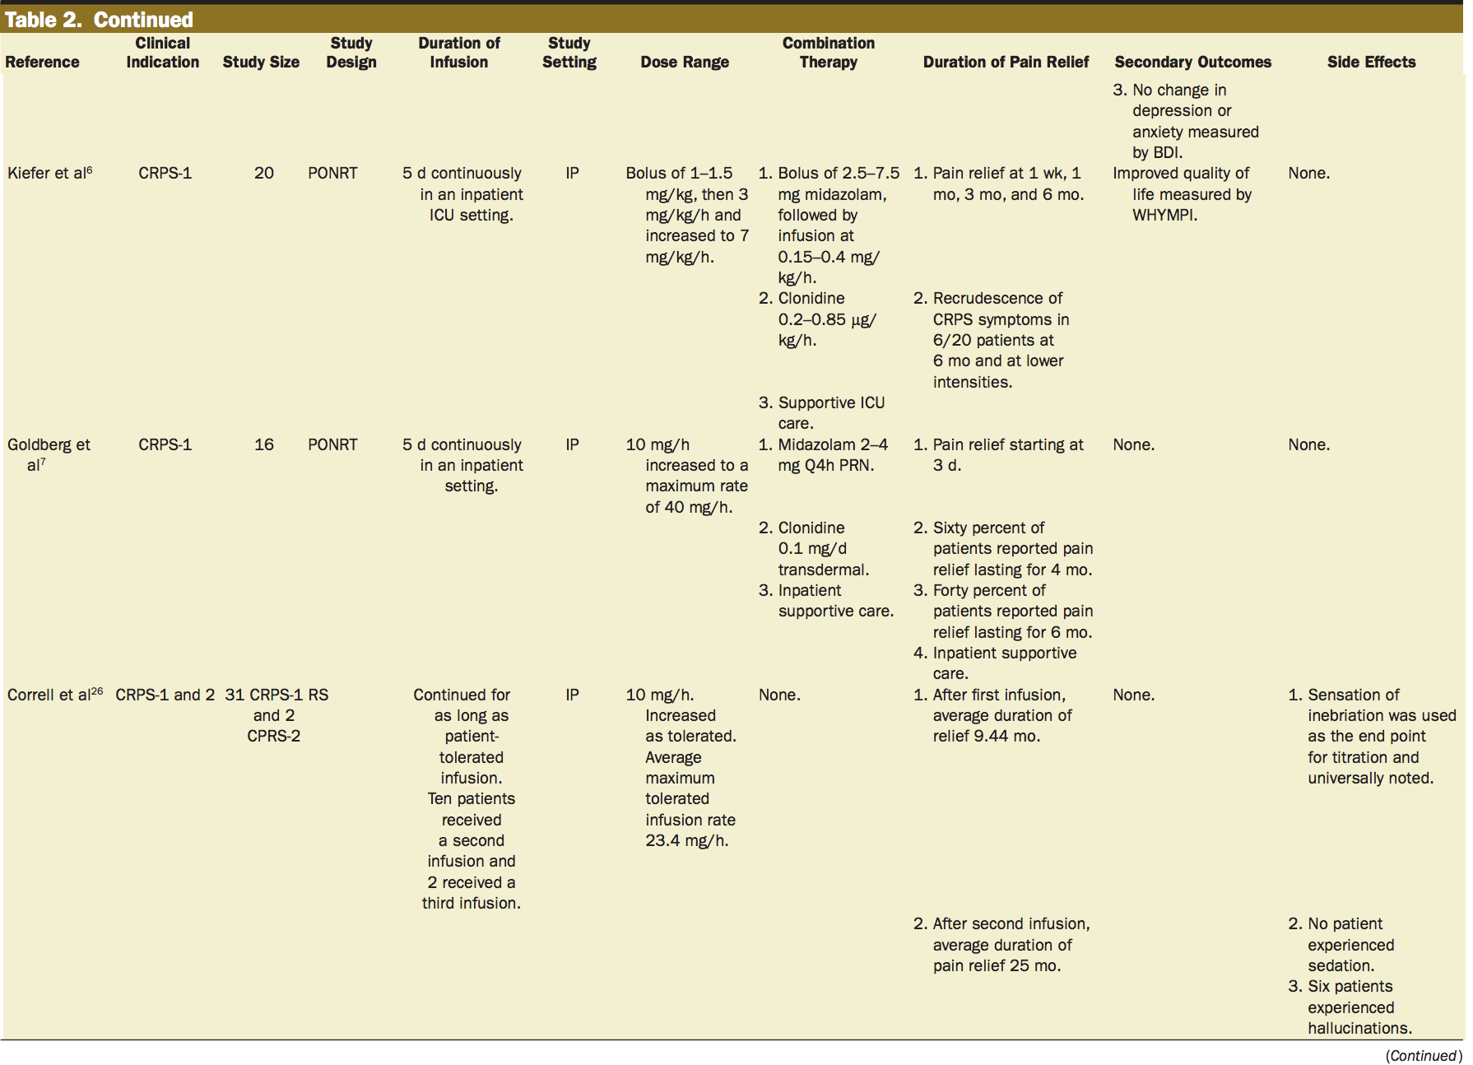

Slide 37
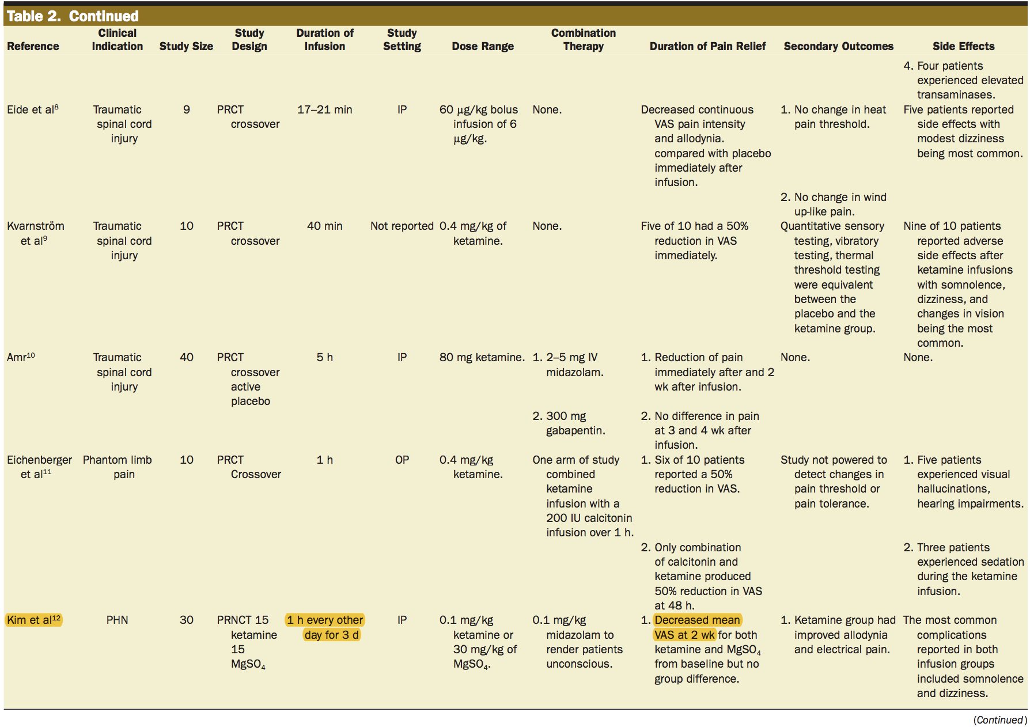

Slide 38
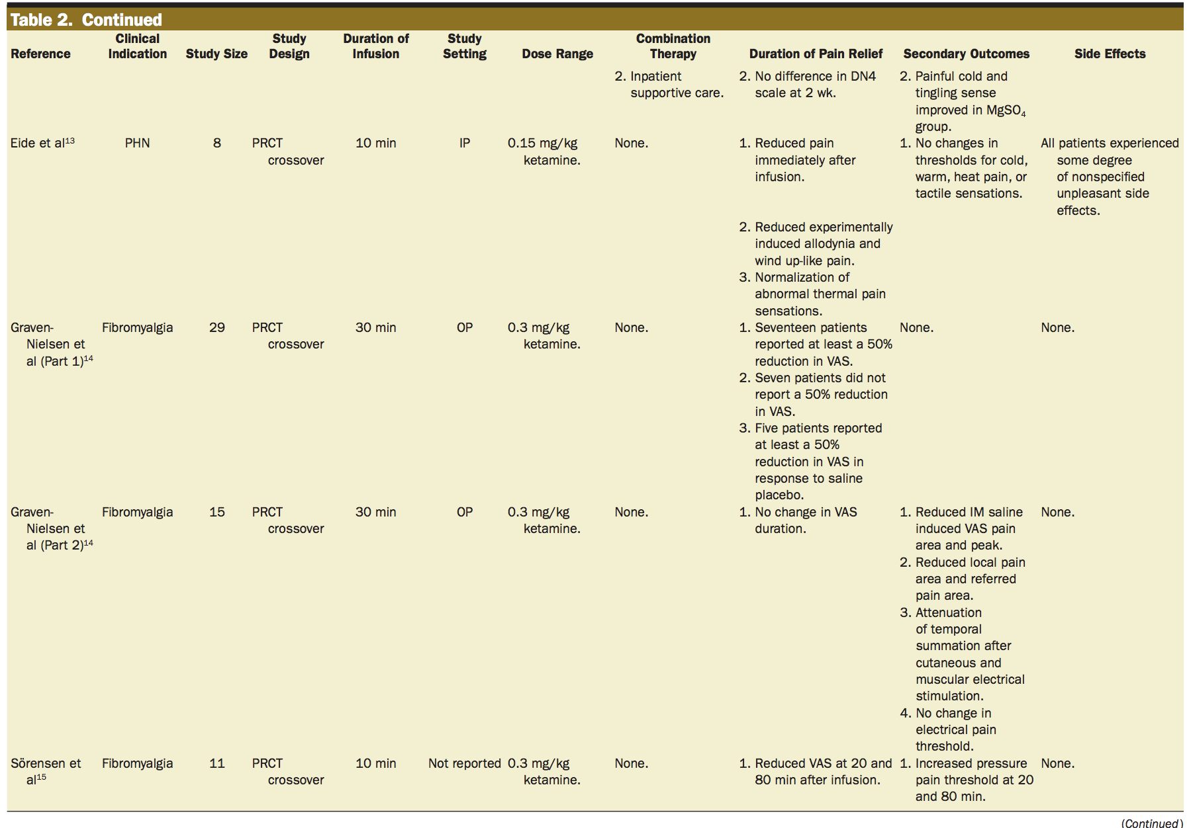

Slide 39
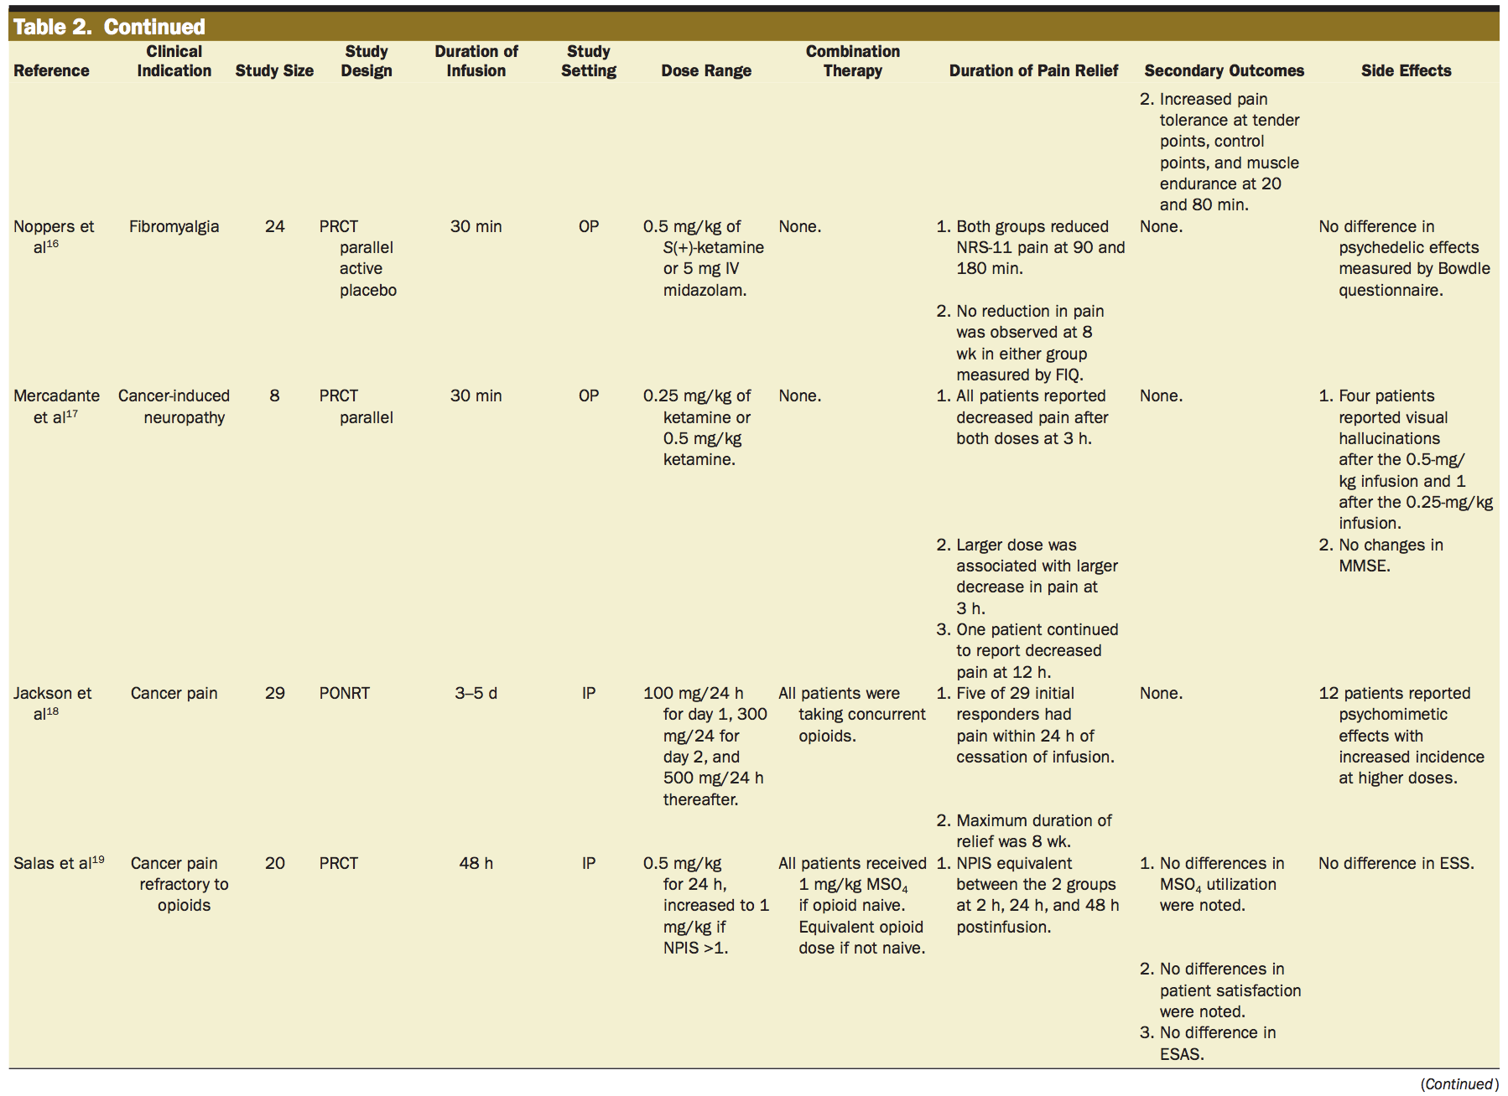

Slide 40
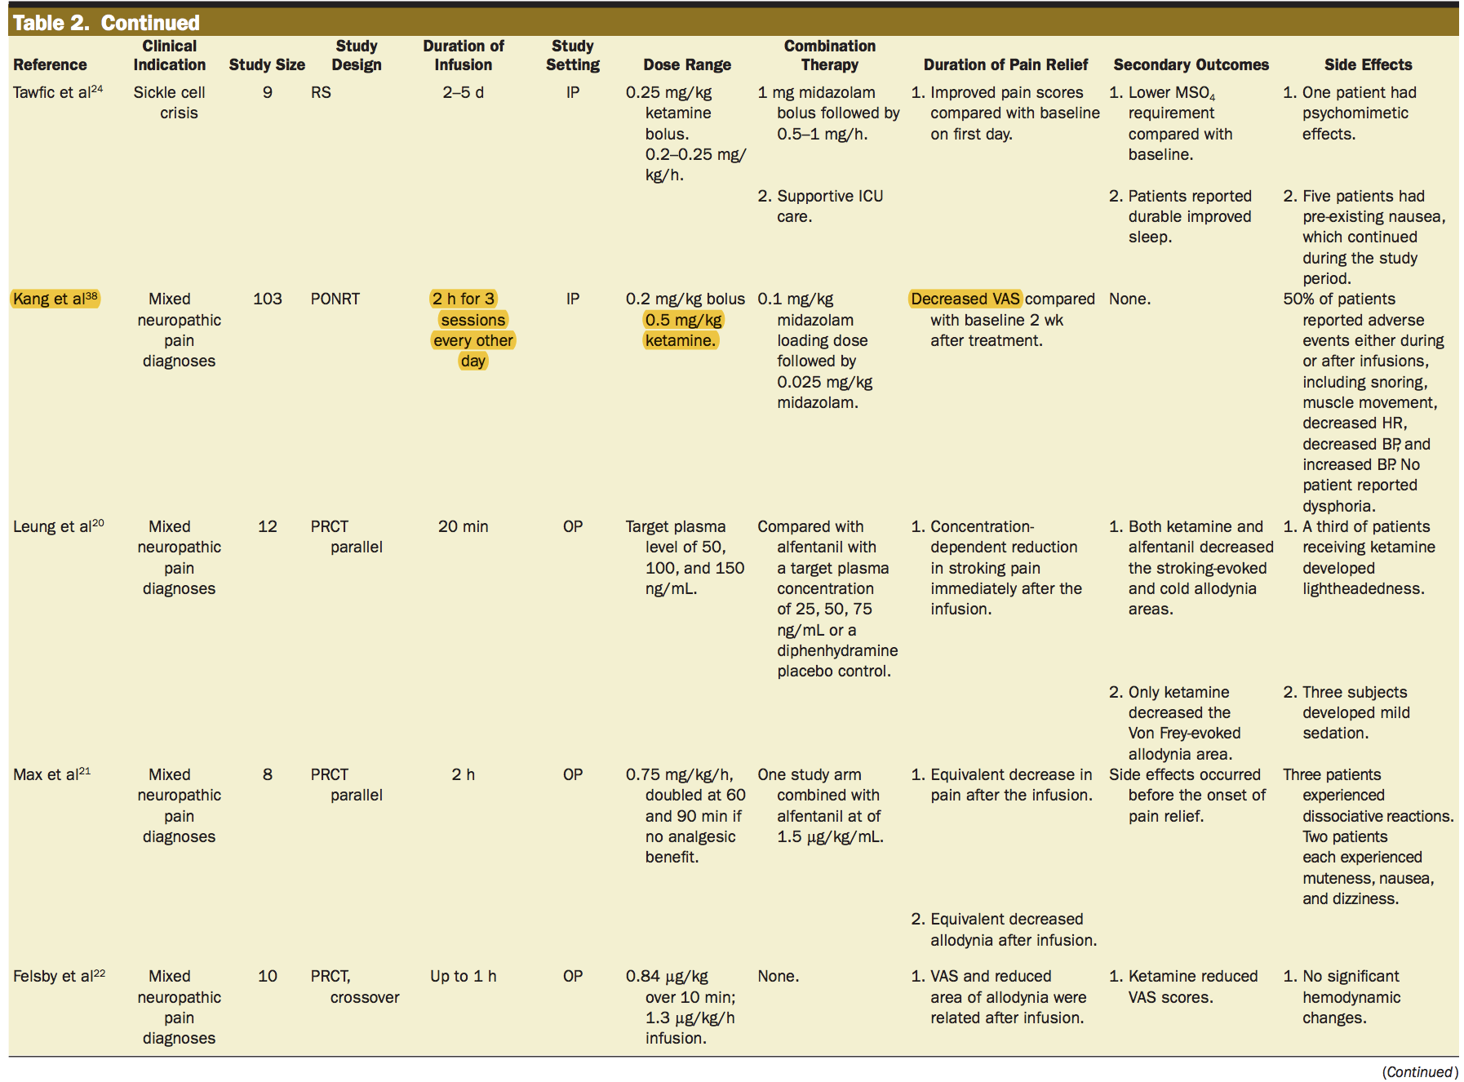

Slide 41
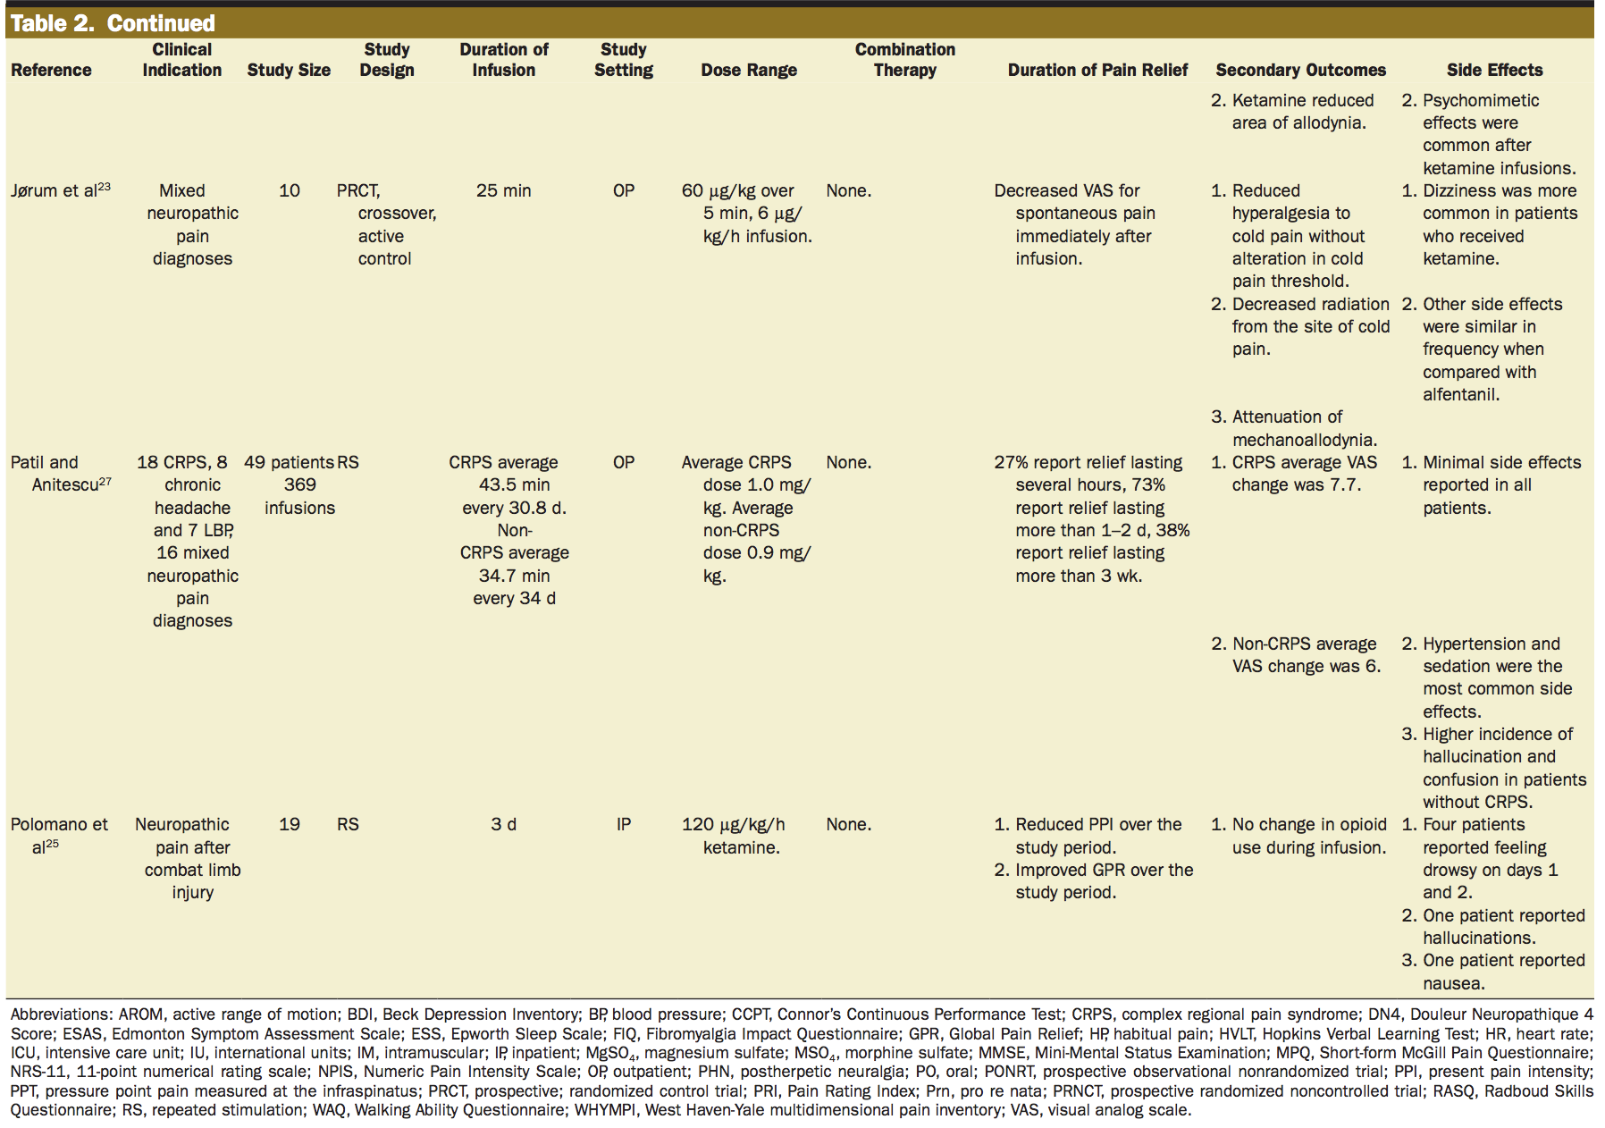

Slide 42
Ketamine Infusion Centers
Most are owned by either Psychiatrist or Anesthesia Professionals
Can be a stand-alone center or in combination with a physician office practice
Average square feet needed will be around 2,000sq/feet
Ideally need a consultation room, waiting room for family, and 2-4 infusion rooms

Slide 43
Ketamine Infusion Centers
Most free-standing centers are set up as physician office extension
Need a DEA number to order drugs and some supplies
Need to establish protocols for handling scheduled drugs
Security is a big concern
AANA Ketamine clinic check list:
https://www.aana.com/docs/default-source/practice-aana-com-web-documents-(all)/ketamine-infusion-therapy-checklistf8fb24731dff6ddbb37cff0000940c19.pdf?sfvrsn=cc0549b1_6

Slide 44
Ketamine for Chronic Pain Protocol
Mix Either 100mg Ketamine/100cc or 250mg/100cc
Calculate initial dose of 1.2mg/kg
Run initial infusion at 0.6mg/kg/hour
Administer adjuncts as needed (Versed/Zofran)
Monitor for at least 30 minutes prior to D/C
Asses VAS Pain score:
Before Each Infusion
After Each Infusion
Weekly for First Month
Monthly for First Year

Slide 45
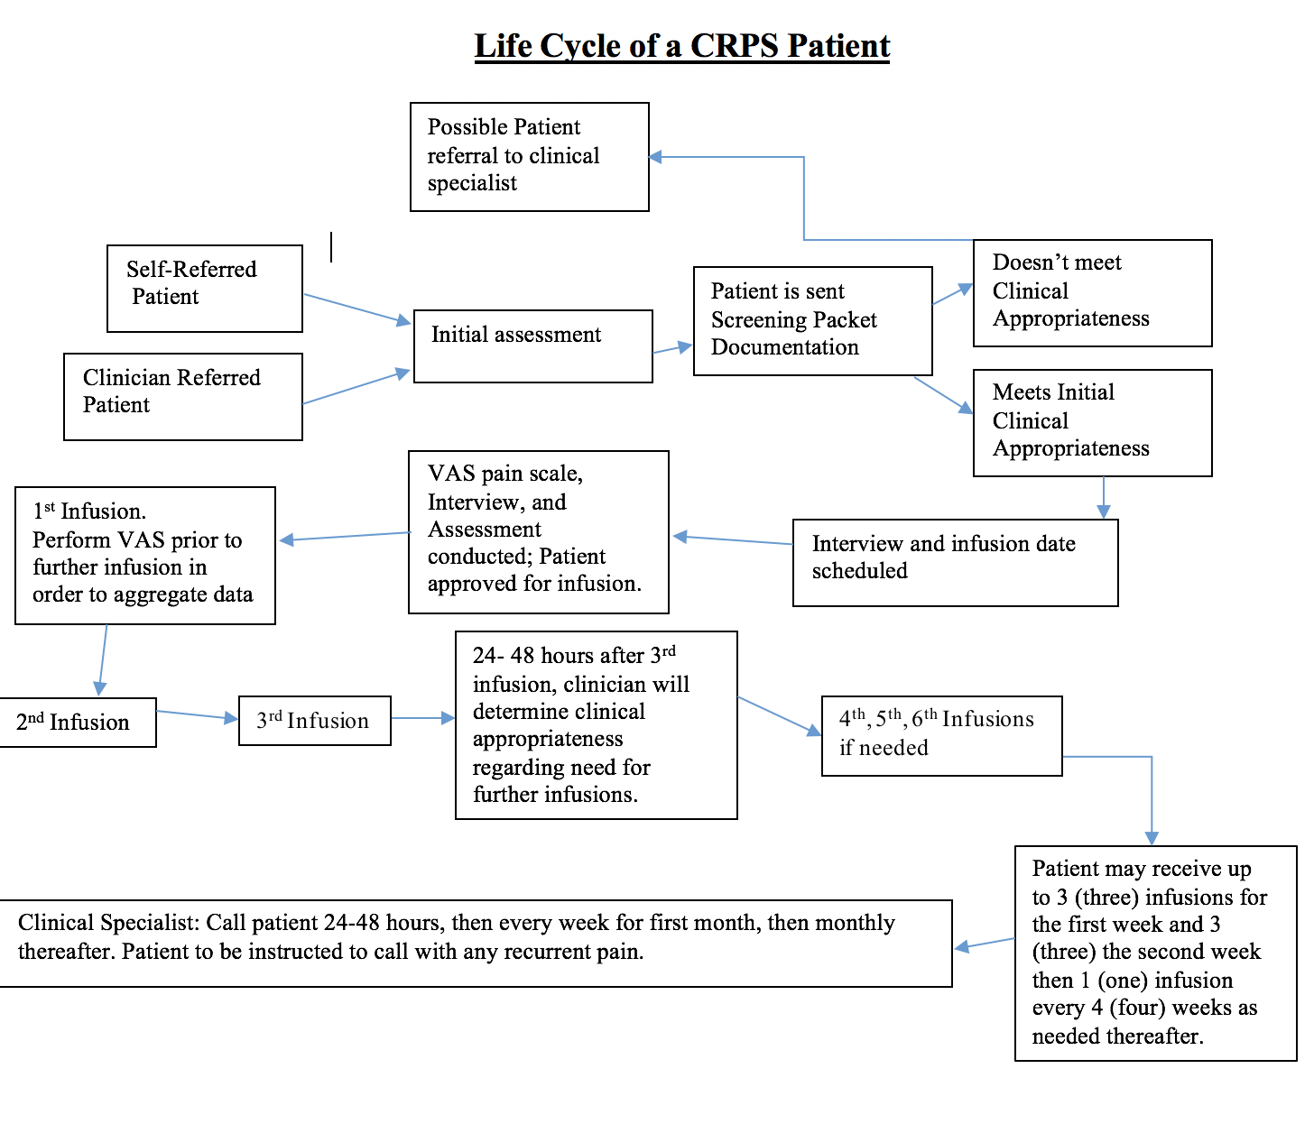

Slide 46
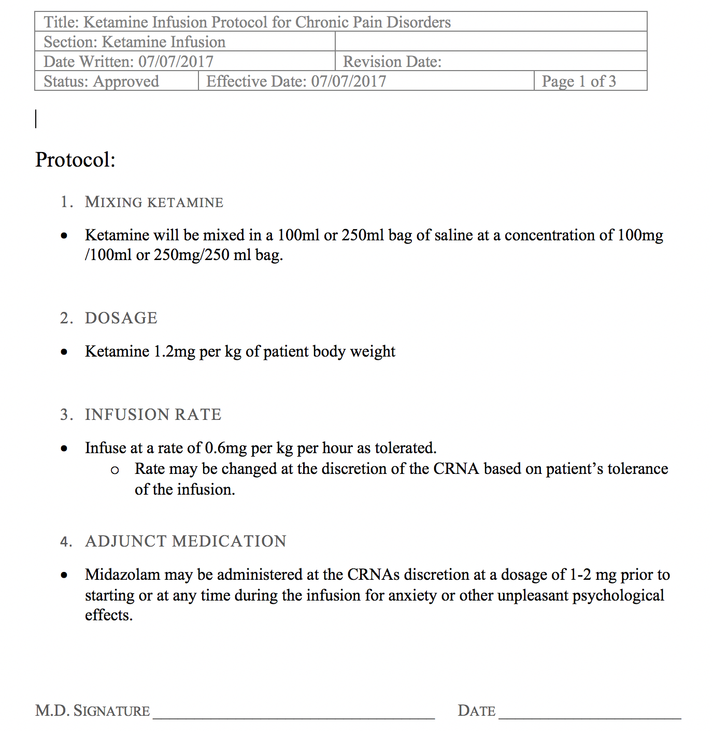

Slide 47
Ketamine for Depression Protocol
Mix Either 100mg Ketamine/100cc or 250mg/100cc
Calculate initial dose of 0.5mg/kg
Run initial infusion at 0.5mg/kg/hour
Administer adjuncts as needed (Versed*/Zofran)
Monitor for at least 30 minutes prior to D/C
Assess Ham D:
Before First Infusion
After 3-6 Infusions
Every other Week for First Month
Monthly for First Year
*Avoid versed if at all possible

Slide 48
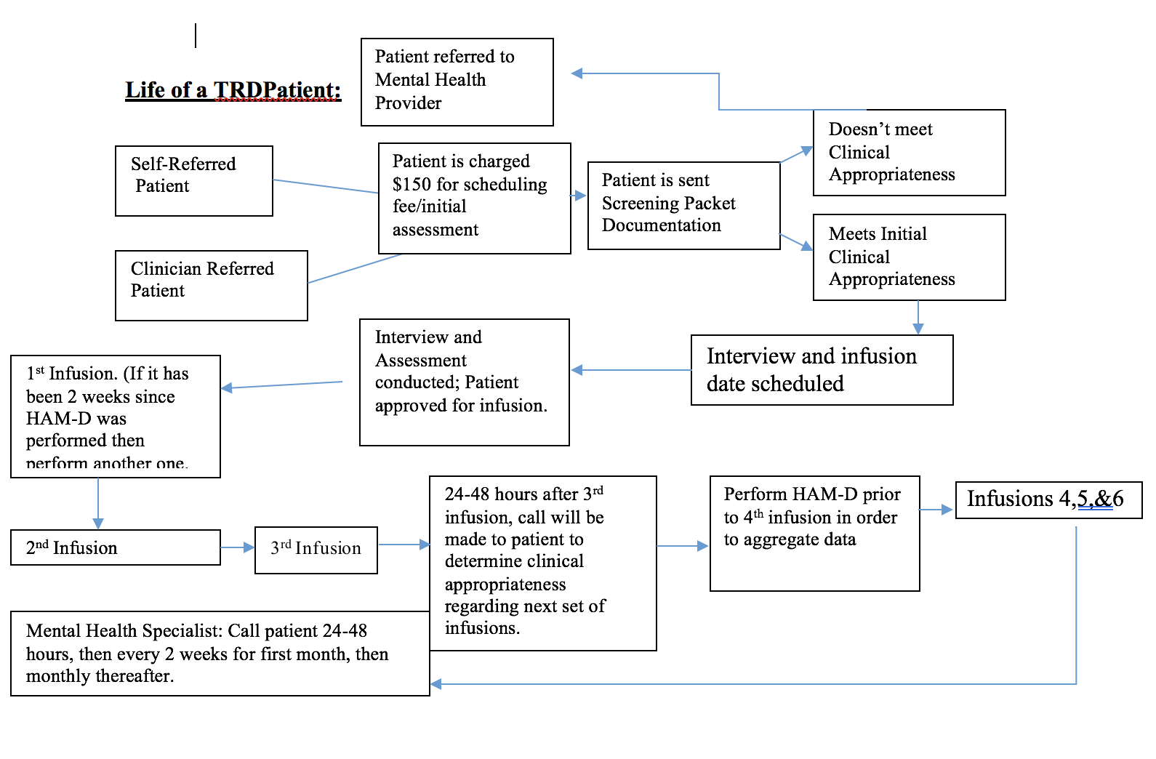

Slide 49
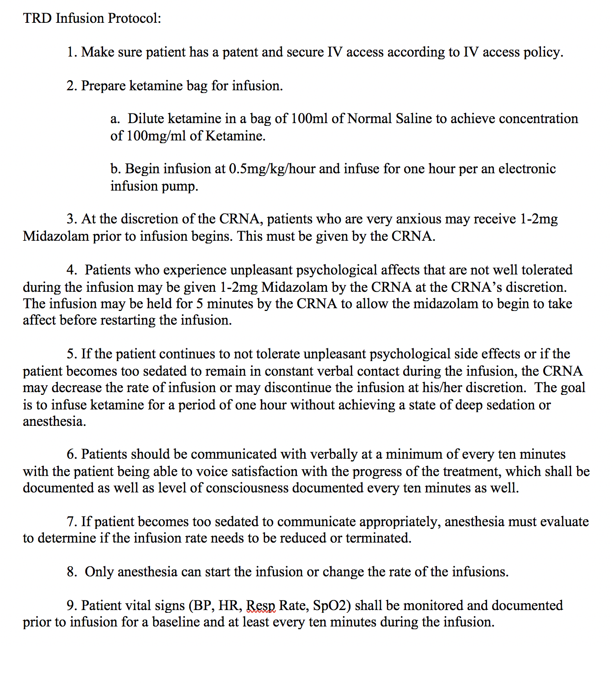

Slide 50
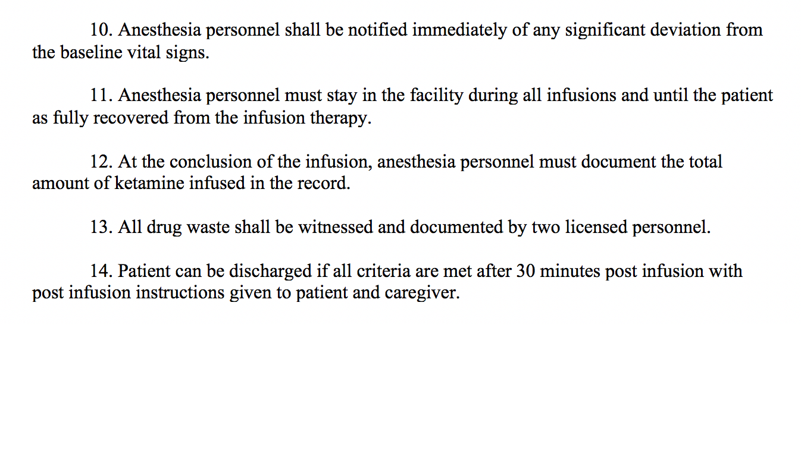

Slide 51
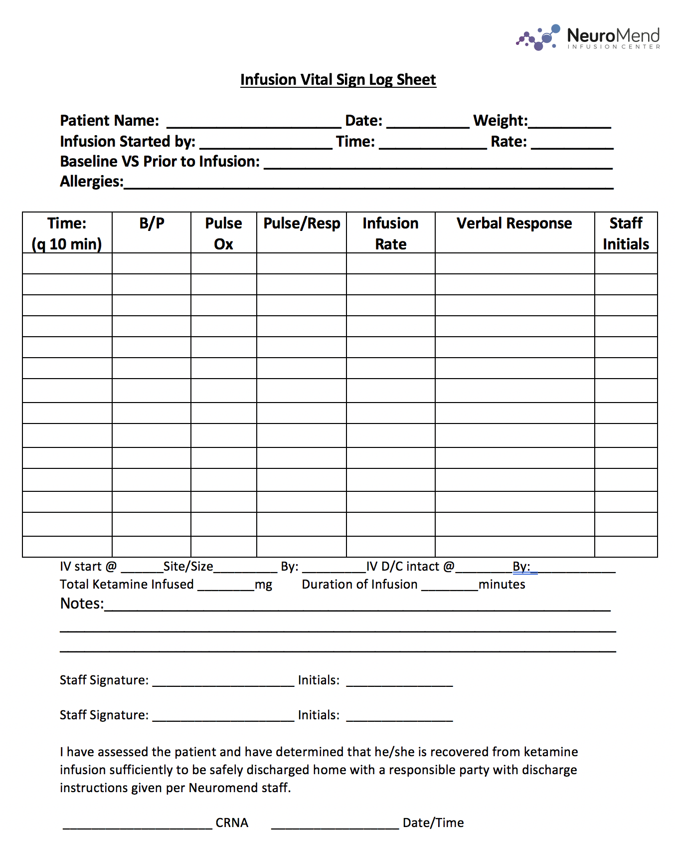

Slide 52
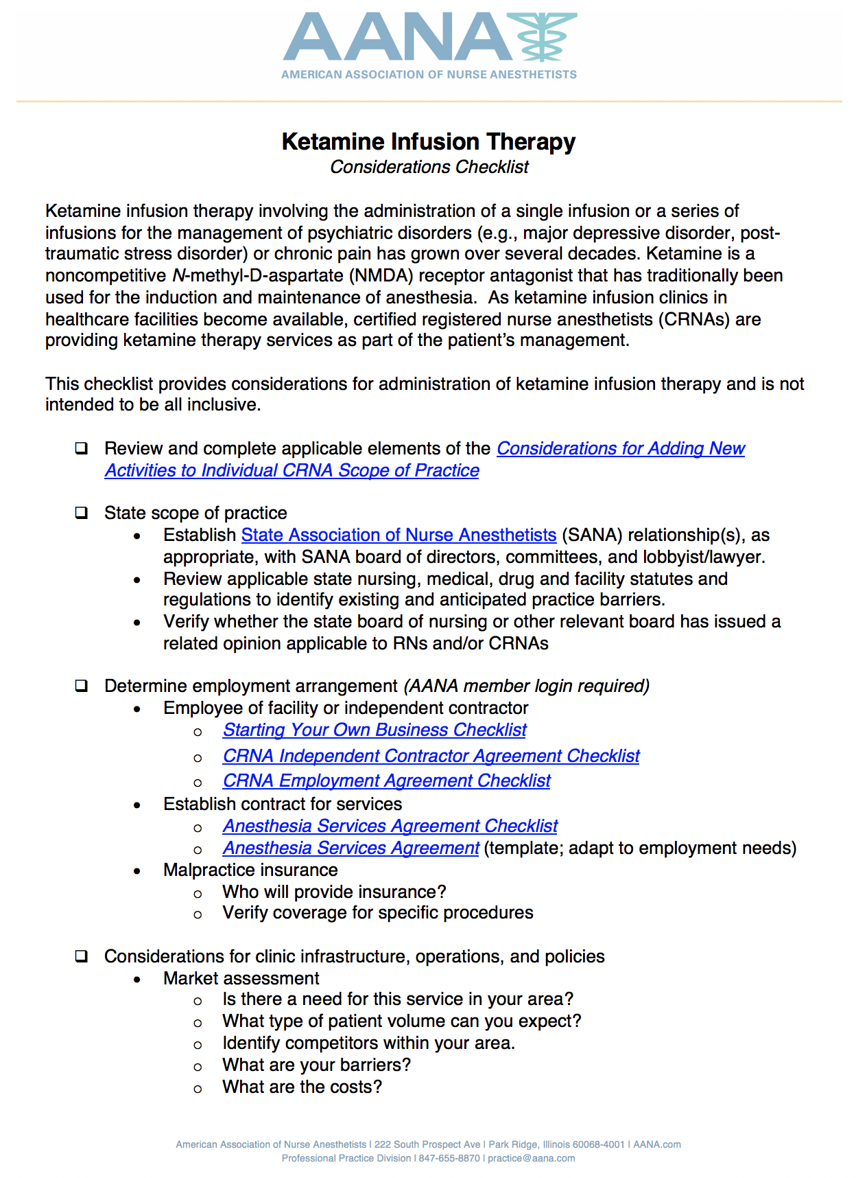

Slide 53
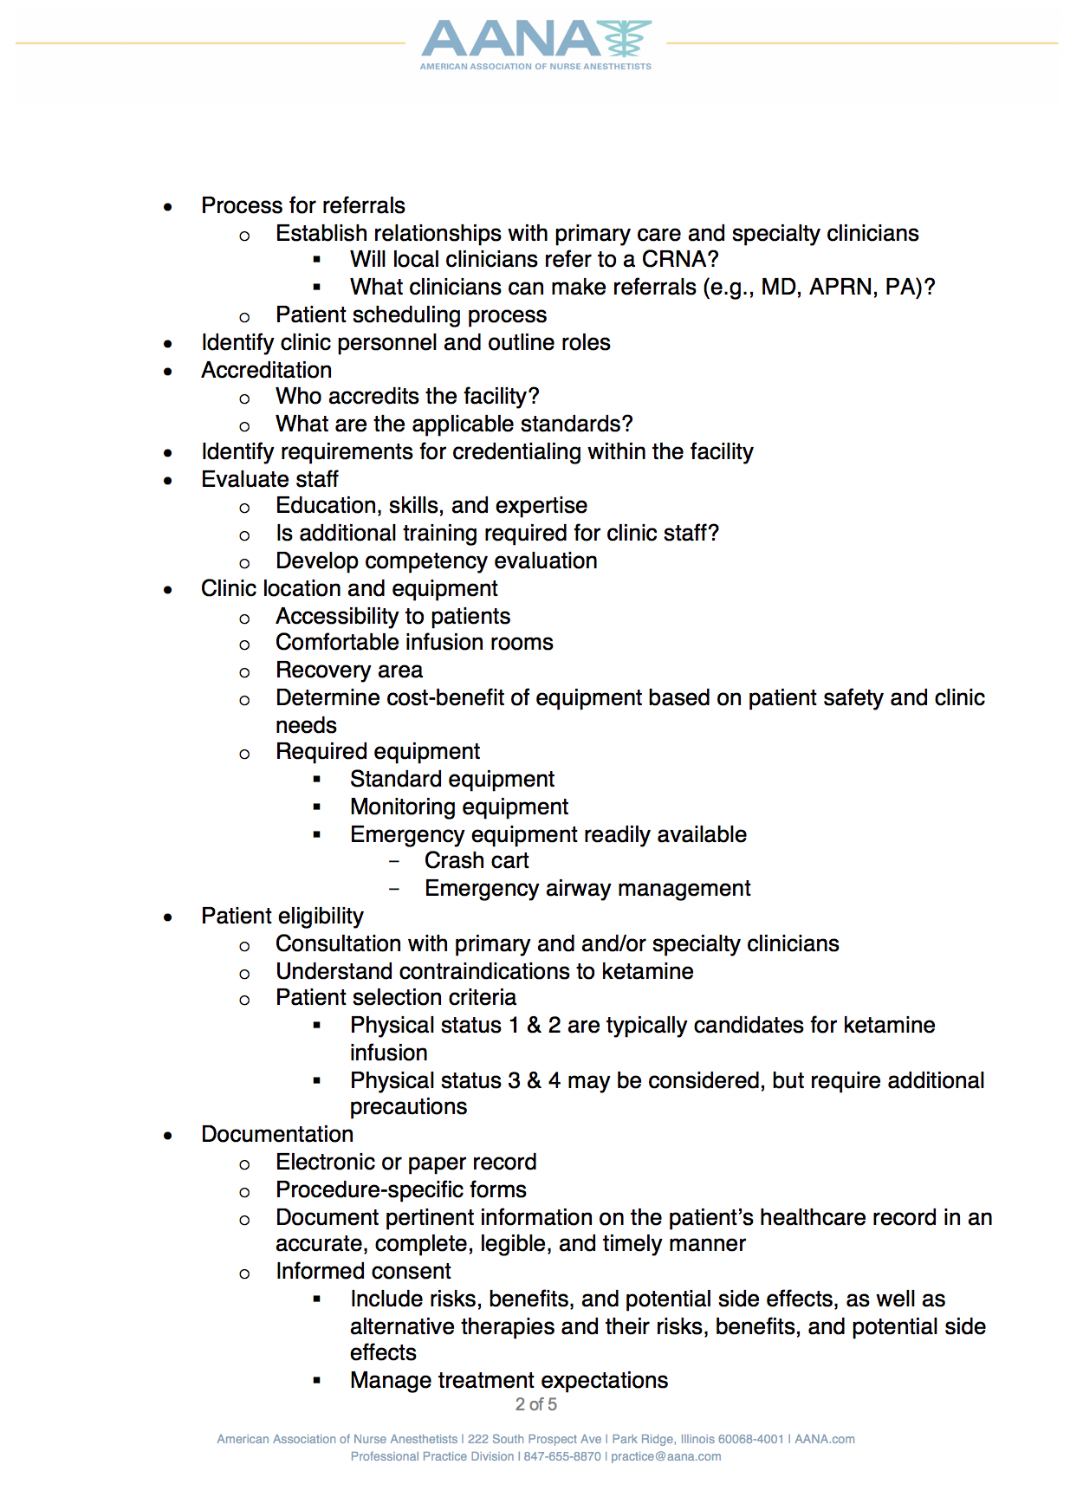

Slide 54
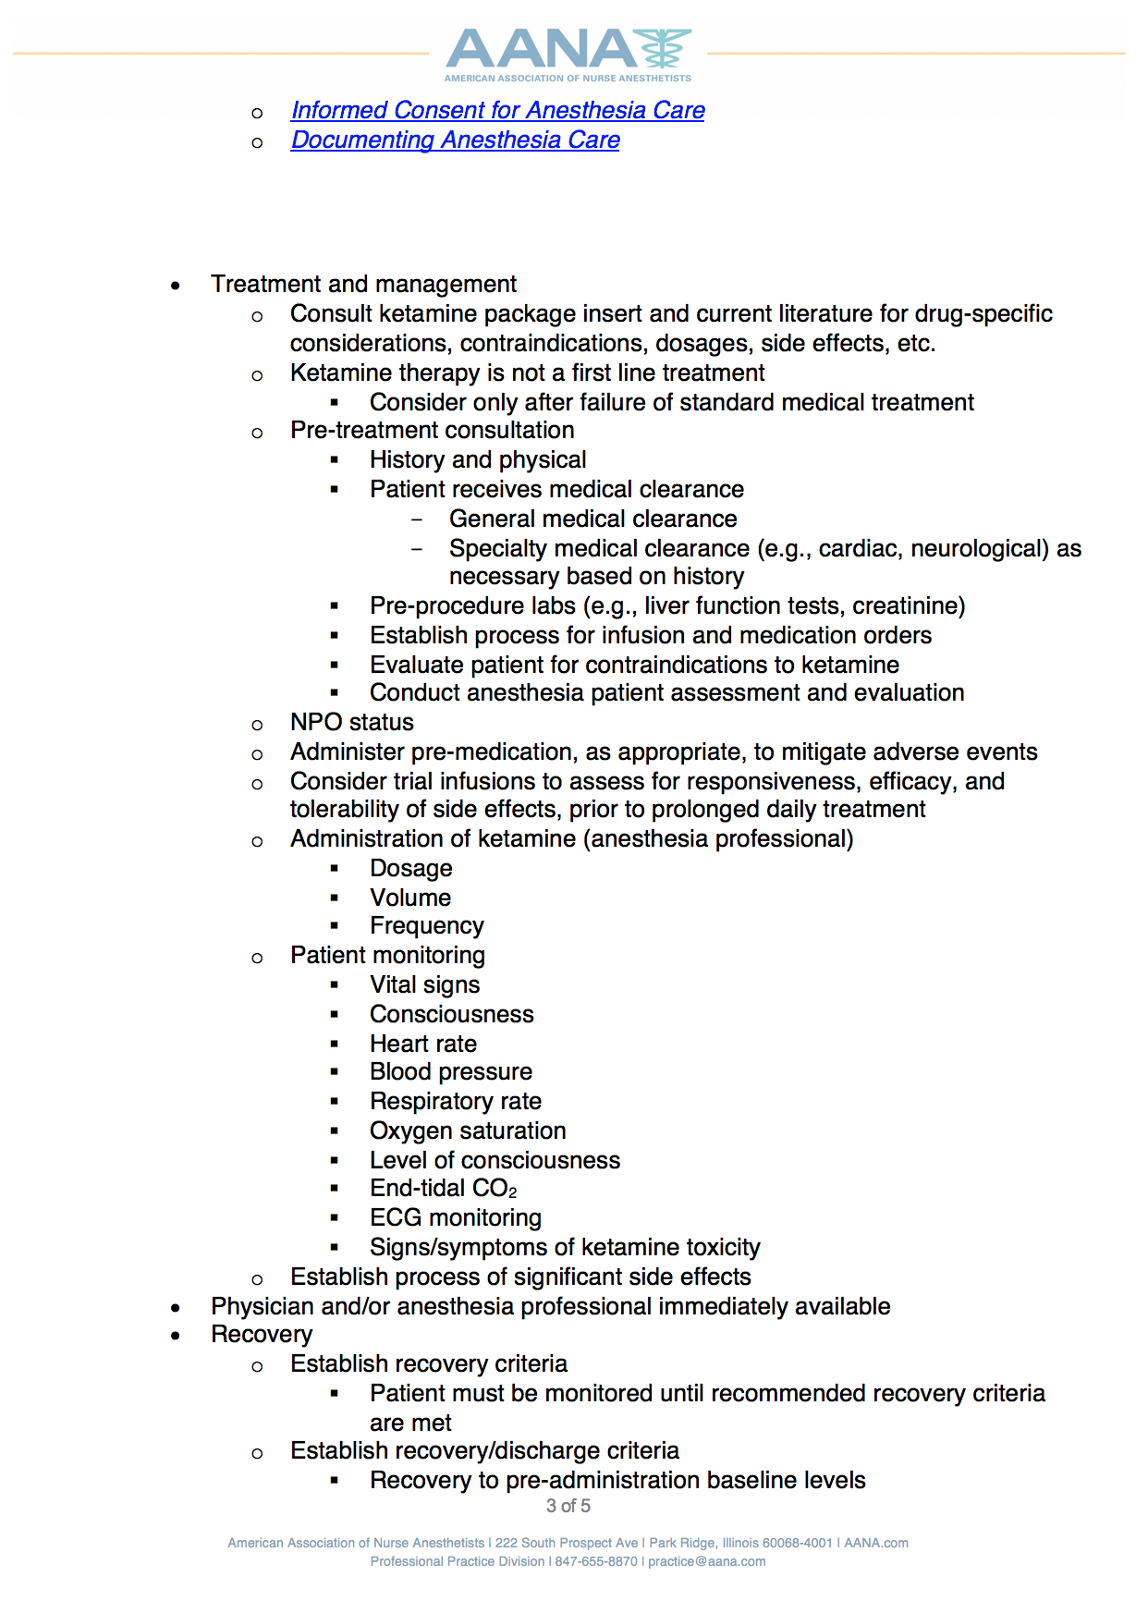

Slide 55
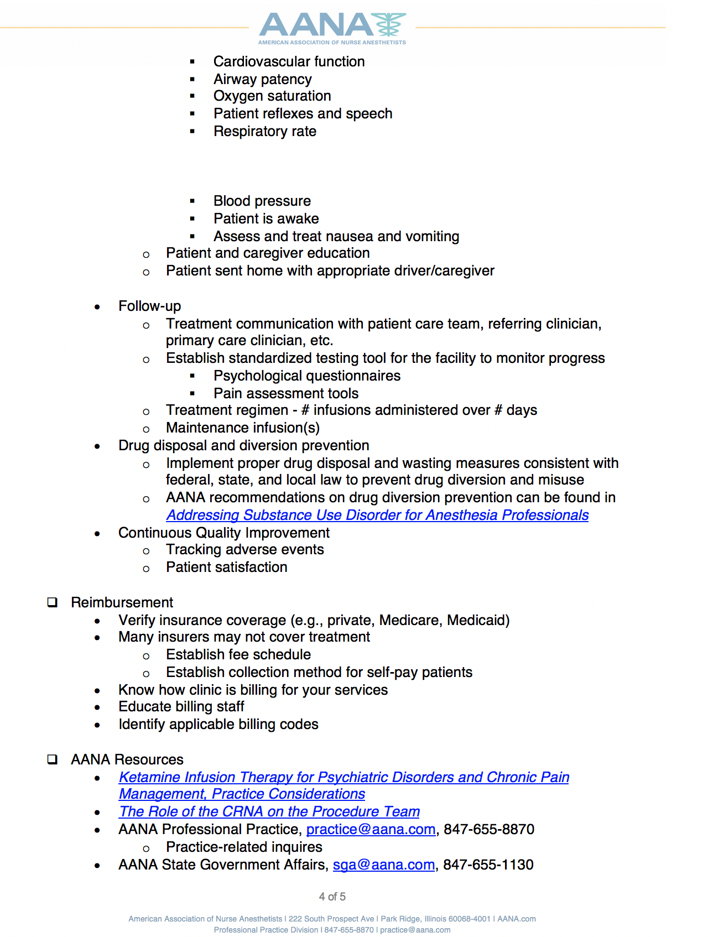

Slide 56
Future of Ketamine
With so many off label uses being studied, some researchers are predicting that Ketamine will soon be listed as more than just an anesthetic.
Researchers are also assessing similar compounds to Ketamine that could deliver similar results to Ketamine without the more untoward side effects and would be able to qualify for patent protection. Update 9/2/2018 J&J filed for FDA Marketing Application for Esketamine Nasal Spray for Depression.
Approved early 2019 (Sparvato Trade name).
Requires REMs certification for storage and monitoring.

Slide 57
Reference List
Domino EF . Taming the ketamine tiger. 1965. Anesthesiology 2010; 113: 678–684.
Zanos P, Gould TD. Mechanisms of ketamine action as an antidepressant. Mol Psychiatry. 2018;23(4):801-811. doi:10.1038/mp.2017.255
Aleksandrova LR, Phillips AG, Wang YT. Antidepressant effects of ketamine and the roles of AMPA glutamate receptors and other mechanisms beyond NMDA receptor antagonism. J Psychiatry Neurosci. 2017;42(4):222-229. doi:10.1503/jpn.160175
Ketamine blocks bursting in the lateral habenula to rapidly relieve depression: Yan Yang, Yihui Cui, Kangning Sang, Yiyan Dong, Zheyi Ni, Shuangshuang Ma& Hailan Hu Nature volume554, pages317–322 (15 February 2018)
Gales, A, Maxwell, S. Ketamine: Recent evidence and current uses. ATOTW 2018;381:1-7
Kurdi MS, Theerth KA, Deva RS. Ketamine: Current applications in anesthesia, pain, and critical care. Anesth Essays Res. 2014;8(3):283-290. doi:10.4103/0259-1162.143110
Corriger A, Pickering G. Ketamine and depression: a narrative review. Drug Des Devel Ther. 2019;13:3051-3067. Published 2019 Aug 27. doi:10.2147/DDDT.S221437
Han Y, Chen J, Zou D, et al. Efficacy of ketamine in the rapid treatment of major depressive disorder: a meta-analysis of randomized, double-blind, placebo-controlled studies. Neuropsychiatr Dis Treat. 2016;12:2859-2867. Published 2016 Nov 3. doi:10.2147/NDT.S117146

Slide 58
Reference List
Feder A, Parides M, Murrough JW, et al. Efficacy of intravenous ketamine for treatment of chronic posttraumatic stress disorder: a randomized clinical trial. JAMA Psychiatry. 2014;71(6):681-688.
Dadiomov D, Lee K. The effects of ketamine on suicidality across various formulations and study settings. Ment Health Clin. 2019;9(1):48-60. Published 2019 Jan 4. doi:10.9740/mhc.2019.01.048
Aura in some patients with familial hemiplegic migraine can be stopped by intranasal ketamine H. Kaube, J. Herzog, T. Käufer, M. Dichgans, H.C. Diener Neurology Jul 2000, 55 (1) 139-141; DOI: 10.1212/WNL.55.1.139
https://migraine.com/blog/ketamine-for-management/
Orhurhu, Vwaire MD, MPH*; Orhurhu, Mariam Salisu MD, MPH†; Bhatia, Anuj MD, FRCPC‡; Cohen, Steven P. MD§,‖ Ketamine Infusions for Chronic Pain: A Systematic Review and Meta-analysis of Randomized Controlled Trials, Anesthesia & Analgesia: July 2019 - Volume 129 - Issue 1 - p 241-254 doi: 10.1213/ANE.0000000000004185

Slide 59
Thank you
for attending!
Notes:
Arial Version – Universally usable

