Slide 1
Best Practice for Anesthesia Management of Older Patients to Maintain Brain Health
Frederick E. Sieber, M.D.
Professor
Department of Anesthesiology and Critical Care Medicine
Director of Anesthesiology
Johns Hopkins Bayview Medical Center
No Relevant Disclosures

Slide 2
Delirium: Definition
Disturbances in attention & awareness
  Acute onset
  Fluctuate over time
Additional change in cognition
Not from:
  Pre-existing neurocognitive disorder
  Severely reduced arousal (coma)
Is from: medical condition, substance, or multiple etiologies
DSM-5, American Psychiatric Association, 2013
Notes:
Diagnostic Criteria
A: A disturbance in attention (i.e., reduced ability to direct, focus, sustain, and shift attention) and awareness (reduced orientation to the environment).
B: The disturbance develops over a short period of time (usually hours to a few days), represents a change from baseline attention and awareness, and tends to fluctuate in severity during the course of a day.
C: An additional disturbance in cognition (e.g., memory deficit, disorientation, language, visuospatial ability, or perception).
D: The disturbances in Criteria A and C are not better explained by another preexisting, established, or evolving neurocognitive disorder and do not occur in the context of a severely reduced level of arousal, such as coma.
E: There is evidence from the history, physical examination, or laboratory findings that the disturbance is a direct physiological consequence of another medical condition, substance intoxication or withdrawal (i.e., due to a drug of abuse or to a medication), or exposure to a toxin, or is due to multiple etiologies.

Slide 3
Symptoms of Delirium in Approximate Order of Specificity
1. Instability of mental status findings over time.
2. Non-auditory hallucinations
(visual hallucinations are symptoms of delirium
until proven otherwise)
3. Misperceptions & illusions.
4. Impaired attention.
5. Disorientation.
6. Impaired level of consciousness.
7. Auditory hallucinations.
8. Delusions.
9. Affective symptoms.

Slide 4


Slide 5
This represents the most common presentation of postoperative delirium
A. True
B. False

Slide 6
Postoperative Delirium Has Many Presentations
Hyperactive (“Wild man”): 1%
Hypoactive (“Out of it”): 68%
Mixed delirium: hypo alternating with hyper (31%)
Arch Surg 2011; 146(3):295-300

Slide 7
Implications of Delirium
risk of death increased from 27.5% to 38%
risk of institutionalization increased from 10.7% to 33.4%
delirium is responsible for $16,303 to $64,421 in additional costs per delirious patient per year with total 1-year health-attributable cost between $38 billion to $152 billion nationally**
risk of developing dementia increased from 8.1% to 62.5%*
Increased duration of mechanical ventilation#
*JAMA 2010; 304:443–451
**Arch Intern Med 2008; 168:27–32
# BMJ 2015;350:h2538

Slide 8
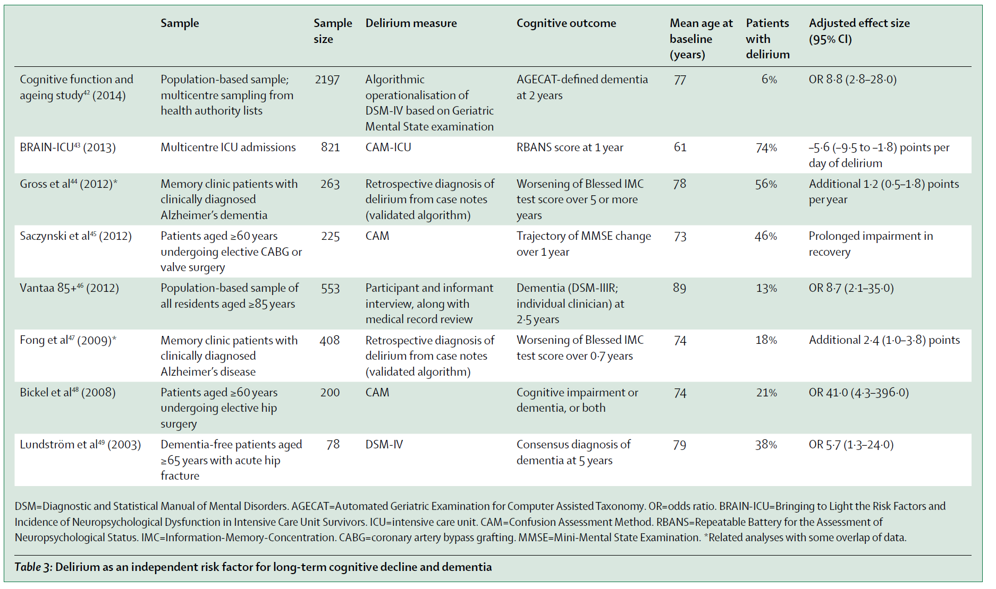
Delirium as an Independent Risk Factor for Long-Term Cognitive Decline and Dementia

Slide 10
Baseline Predisposing Risk Factors for Delirium
NICE Pathway
65 years or older
Cognitive impairment (past or present) and/or dementia
Current hip fracture
Severe illness (a clinical condition that is deteriorating or is at risk of deterioration)
National Institute for Health and
Care Excellence

Slide 11
Incidence of Cognitive Impairment in Elderly Elective Surgical Patients
Silbert et al., 2015: Total hip replacement - 32%
Partridge et al., 2014: Vascular surgery – 68%
Robinson et al., 2012: Elective surgery requiring ICU admission – 40%

Slide 12
A Simple Way of Screening for Dementia is to Use
the Mini-cog Test

Slide 13
Odds ratio for postoperative delirium in frail vs non-frail patients:
OR=2.1 [1.4-3.2]

Slide 14
Consensus Statement
“All patients over age 65 should be informed of the risks of PND including confusion, inattention, and memory problems after having an operation.”
  Anesthesia or surgery may contribute to delirium and/or cognitive dysfunction
  Multidisciplinary team approach should include consent
  Risks of surgery and anesthesia now include longer term sequelae

Slide 15
Epidemiology of Delirium
Community prevalence: The Baltimore ECA study
  Delirium in general adult population in community
  Point prevalence all individuals: 0.4% - 18 and above
  Age 55 and above: 1.1%
  Age 85 and above: 14%
Nursing Home prevalence:
  Elderly 75 y/o and older at any given time: 60%
Hospital prevalence:
  Presenting to ED: 10%
  All medical and surgical inpatients (during stay): 10-15%
  Elderly Medical/Surgical Inpatients: 15-25%
  Elderly with cognitive impairment: 45%
  Elderly post-op from hip fracture: 45-65%
  Nursing homes: 60%
  MICU/SICU/CCU: 32% (Salluh BMJ 2015; 350:h2538)
  Terminally ill/ end of life: 85%

Slide 16
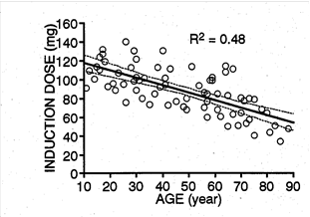
Effect of age on propofol induction dose
Anesthesiology 94:205

Slide 17
      T 1/2 b – Elimination Half-life
Drug Young Adults Old Adults
Fentanyl 250 min 925 min
Diazepam 24 hrs 72 hrs
Midazolam 2.8 hrs 4.3 hrs
Vecuronium* 16 min 45 min
*(Return of twitch height from 25 percent to 75 percent of control)

Slide 18
Aging influences MAC
Used with permission from Eger EI, Weiskopf RB, Eisenkraft JB, eds. The Pharmacology of Inhaled Anesthetics. Baxter Healthcare Corporation, New Providence, New Jersey, 2002: 24

Slide 19
Recommendation for Intraoperative Measures to Prevent Delirium
The anesthesia practitioner may use processed electroencephalographic monitors of anesthetic depth during general anesthesia of older patients to reduce postoperative delirium

Slide 20
Cognitive Dysfunction after Anesthesia (CODA) Trial-Elective Major Surgery BIS Guided General Anesthesia
 | BIS | Routine care | OR | P
MAC | 0.57+0.29 | 0.93+0.34 |  | < 0.001
Delirium | 15.6% | 24.1% | 0.58(0.41-0.80) | 0.01
J Neurosurg Anesthesiol 2013; 25(1):33-42

Slide 21
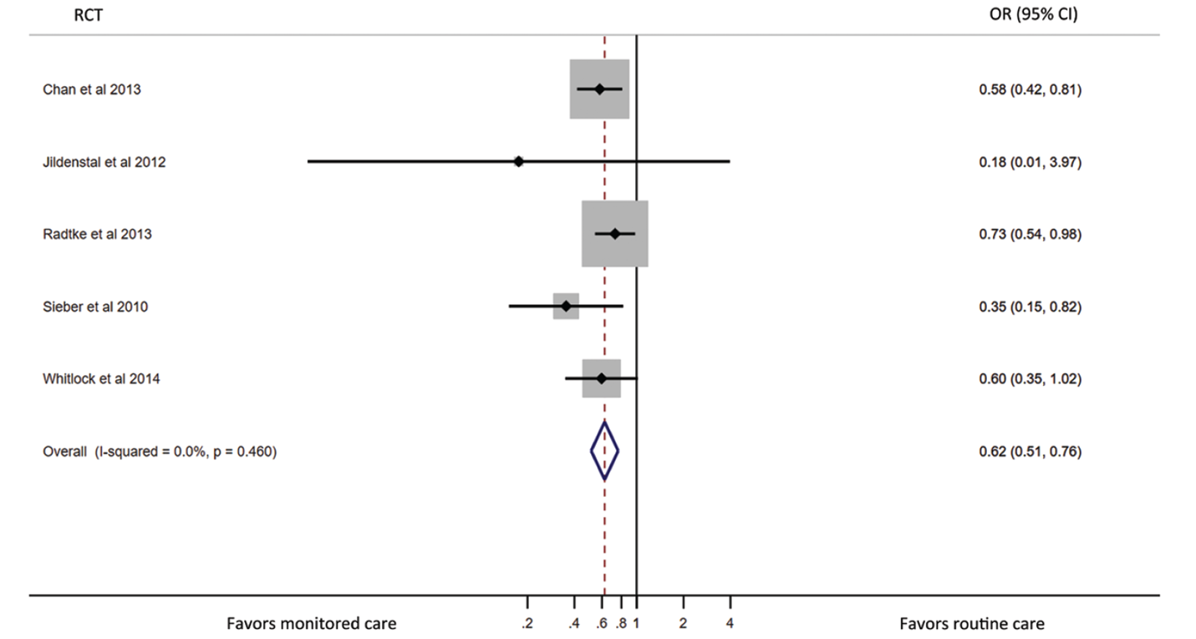
Forest Plot of comparison:
Bispectral index (BIS)-Guided Anesthesia versus
BIS-Blinded Anesthesia, Outcome: Incident Delirium
Anesthesiology 2018; 129:417-27

Slide 22
Incidence of Delirium by EEG Suppression Divided into Quartiles Based on Duration of EEG Suppression
Anesth Analg 2016;122:234-42

Slide 23
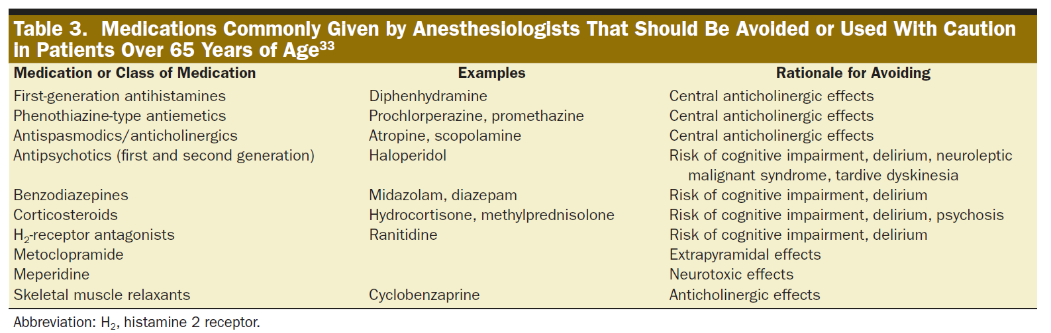
Minimize Drugs Associated with CNS Effects eg-Psychoactive Medications and Sedatives
Anesth Analg 2016;122:234-42

Slide 24
Is regional anesthesia better?
Literature is confusing
No differences between spinal and general anesthesia in delirium rates after hip fracture repair

Slide 25
Forest Plot Showing Pooled Effect Estimate for Delirium Comparing Regional with General Anesthesia
British Journal of Anaesthesia, 120(1): 37e50 (2018

Slide 26
Confounders in Literature
Depth of sedation has not been controlled
Elderly patients need very little anesthetic to be deeply sedated

Slide 27
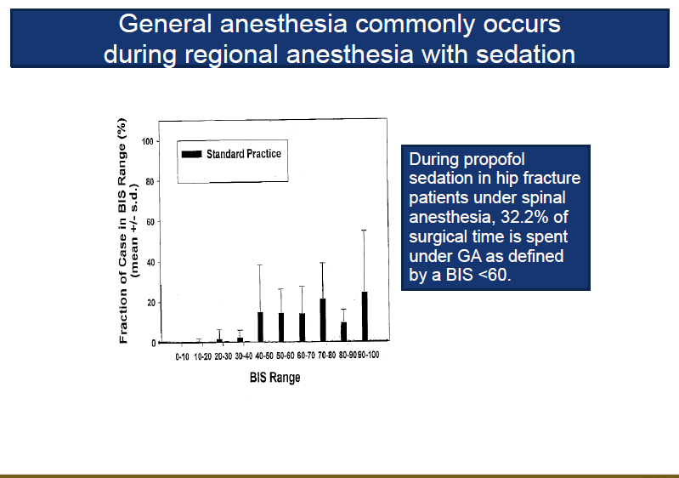
General anesthesia commonly occurs during a spinal
During propofol sedation in hip fracture patients 32.2% of surgical time was spent under GA as defined as BIS <60

Slide 28
Limiting the Level of Sedation Provided No Significant Benefit in Reducing Incident Delirium
JAMA Surg. 2018;153(11):987-995

Slide 29
Recommendations for Perioperative Measures to
Prevent Delirium
Provide regional anesthetic at the time of surgery and postoperatively to improve pain control
Optimize postoperative pain control, preferably with non-opioid pain medications

Slide 30
Nerve Blockade Versus No Blockade for Hip Fracture:
Effect on Delirium
 | Study | Effect in Favor of Nerve Blockade (OR)
Randomized controlled trial
 | Foss et al., 2005 | 0.33 [0.16 to 0.66]
 | Monzon et al., 2010
 | Mouzopoulos et al., 2009
 | Graham et al., 2008
Cohort
 | Del Rosario et al., 2008 | 0.24 [0.08 to 0.72]
 | Pedersen et al., 2008
Abou-Setta A M et al. Ann Intern Med;2011

Slide 31
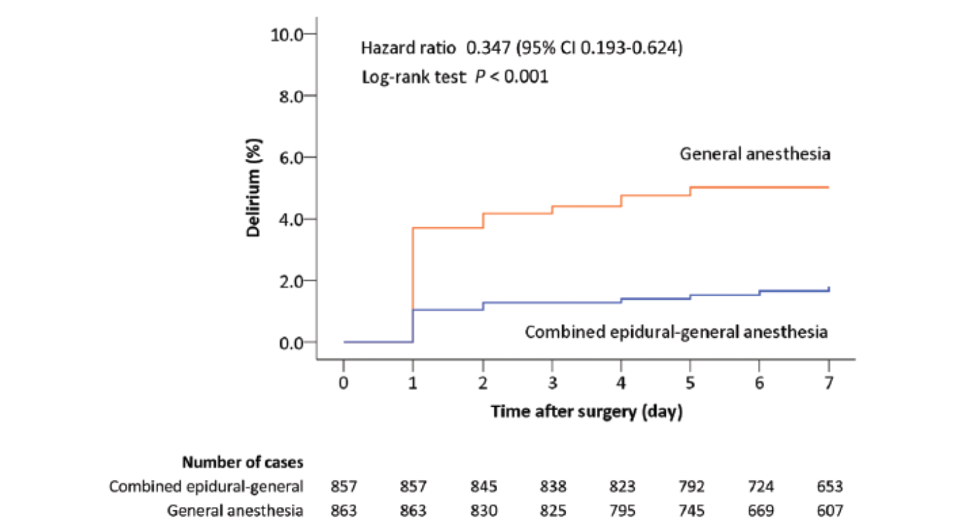
Probability of postoperative delirium by day 7 after surgery
Anesthesiology 2021; 135:218–32

Slide 32
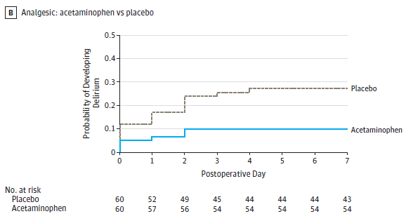
Post-hoc Kaplan-Meier Analysis for Time to Delirium:
Acetaminophen vs Placebo
JAMA. 2019;321(7):686-696

Slide 33
Postoperative Pain Management With Narcotics -
Systematic Review
  Meperidine is the only drug that should be avoided.
There is no difference in cognitive outcome when comparing fentanyl vs. morphine vs. hydromorphone
There is no difference in cognitive outcome when comparing epidural vs. IV administration of narcotics for postoperative analgesia
Anes Analg 102:1255, 2006

Slide 34
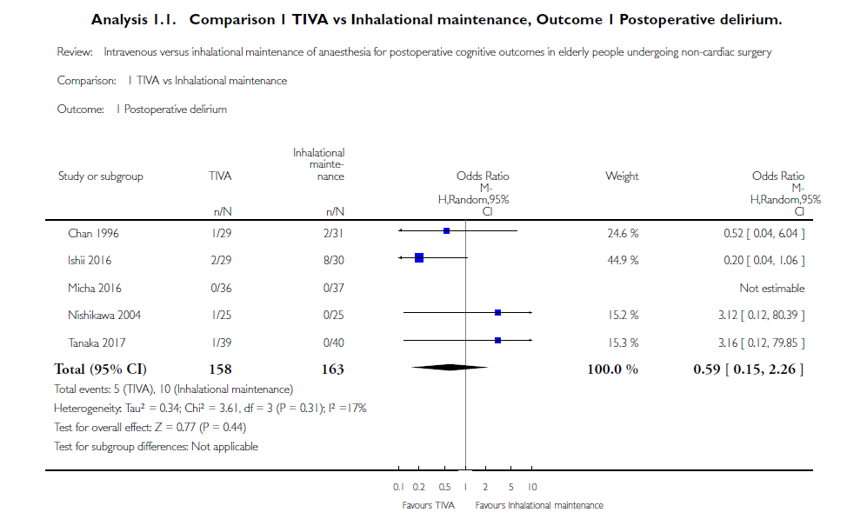
Forest Plot Showing Pooled Effect Estimate for Delirium Comparing TIVA vs Inhalational Maintenance of General Anesthesia
Cochrane Database of Systematic Reviews 2018, Issue 8. Art. No.: CD012317.
DOI: 10.1002/14651858.CD012317.pub2.

Slide 35
No Pharmacologic agent consistently prevents delirium*
Cholinesterase inhibitors-including physostigmine
Melatonin-including ramelteon
Statins
ketamine

Slide 36
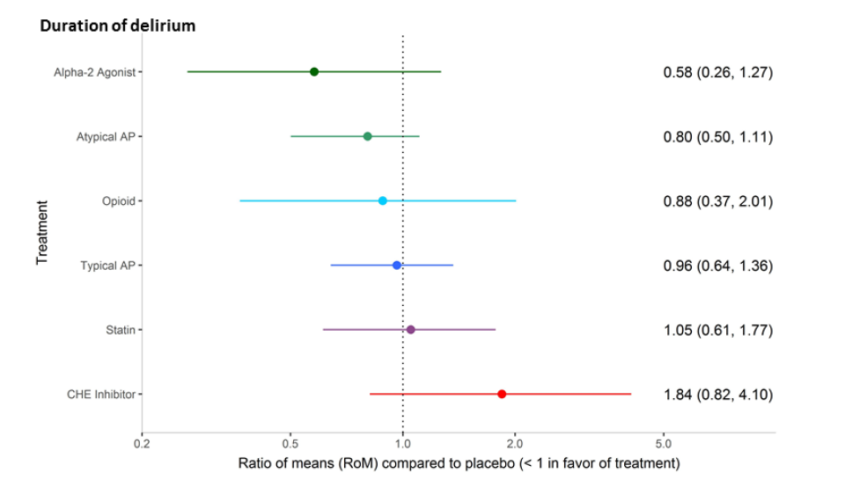
network meta-analysis: effects of pharmacologic approaches on duration of delirium

Slide 37
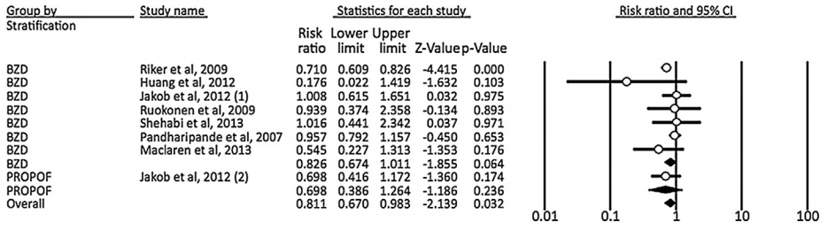
Dexmedetomidine vs Propofol/Benzodiazepines Associated with Less Delirium When Used as Sedative Agent in ICU
Anaesth Crit Care Pain Med 2016;35:7-15
Notes:
? Cut off the propofol comparison?

Slide 38

Both very high and very low levels of mean surgery MAP are associated with increased risk of postoperative delirium
Wang NY, Hirao A, Sieber F (2015) Association between Intraoperative Blood Pressure and Postoperative Delirium in Elderly Hip Fracture Patients. PLoS ONE 10(4): e0123892. doi:10.1371/journal.pone.0123892
http://127.0.0.1:8081/plosone/article?id=info:doi/10.1371/journal.pone.0123892

Slide 39
Does Anesthesia Cause Postoperative
Cognitive Decline?

Slide 40


Slide 41
Summary of Commonly Used Anesthetics on Aβ Accumulation and Aβ Oligomerization
 | Cells | Animals | Humans
Isoflurane | Positive a. 0–10 mM isoflurane (Eckenhoff et al., 2004). b. H4 human neuroglioma cells; 1.4% isoflurane for 6 h (Xie et al., 2006; Xie et al., 2007). | Positive a. Wild-type mice; 1.4% isoflurane for 2 h (Xie et al., 2008). b. AbetaPP[swe] mice; 2% isoflurane for 20 min twice a week for three months (Perucho et al., 2010). | Unknown
Sevoflurane | Positive H4 human neuroglioma cells; 4.1% sevoflurane for 6 h (Dong et al., 2009). | Positive a. Wild-type mice; 2.5% sevoflurane for 2 h (Dong et al., 2009). b. Wild-type mice; 3% sevoflurane for 6 h (Lu et al., 2010). | Unknown
Desflurane | Negative H4 human neuroglioma cells; 12% desflurane for 6 h (Zhang et al., 2008a, 2008b). | Unknown | Unknown
Nitrous Oxide | Negative H4 human neuroglioma cells; 70% nitrous oxide for 6 h (Zhen et al., 2009). | Unknown | Unknown
Propofol | Negative a. 0–100 μM (Eckenhoff et al., 2004). b. 100 μM propofol, H4 human neuroglioma cells (Zhang et al., 2011). | Unknown | Unknown
Ref: Progress in Neuro-Psychopharmacology & Biological Psychiatry 47 (2013) 140–146

Slide 42
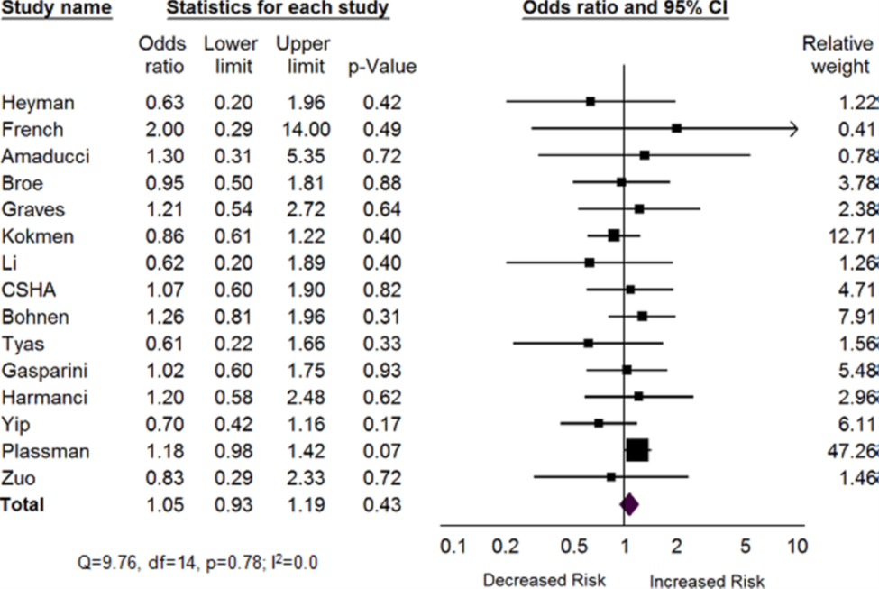
Forest Plot of Any Exposure to General Anesthesia and Alzheimer’s Disease
Ref: Seitz et al. BMC Geriatrics 2011, 11:83

Slide 43
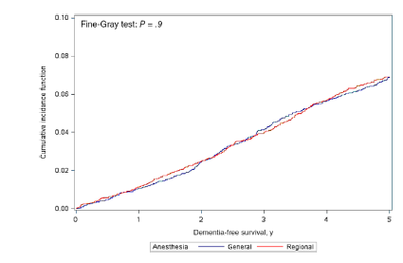

Cumulative incidence function curve comparing time with diagnosis of dementia for individuals who received general anesthesia when compared with regional anesthesia

Slide 44
Non-Pharmacologic Multicomponent and Multidisciplinary Interventions

Slide 45
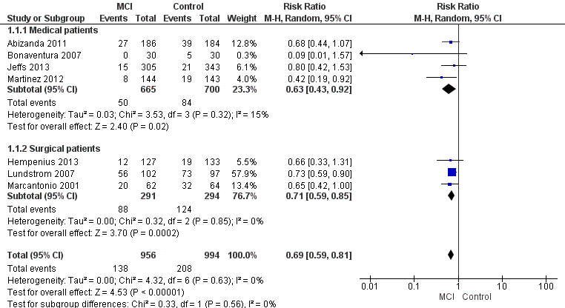
Multi-Component Delirium Prevention Intervention (MCI) Versus Usual Care, Outcome: Incident Delirium
Cochrane Database of Systematic Reviews
2016, Issue 3. Art. No.: CD005563

Slide 46
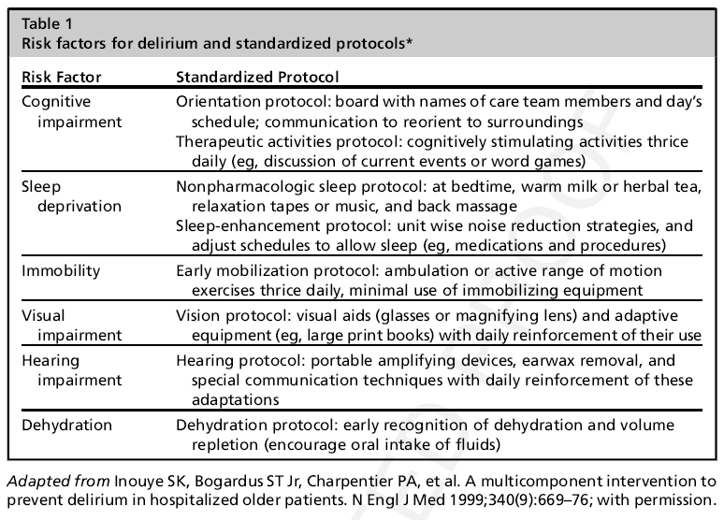

Slide 47
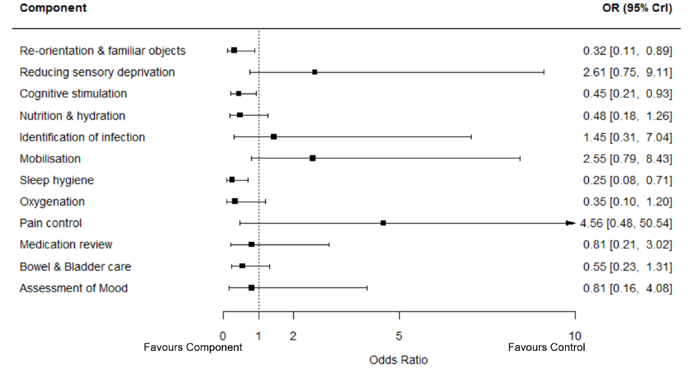


Slide 48
Limited evidence incidence of postoperative delirium can be decreased by Prehabilitation
Time is a limiting factor
Lack of robust data in form of adequately powered RCT

Slide 49
Summary of Perioperative Recommendations for Maintaining Brain Health
Preoperative cognitive screening
Include discussion of postop cognitive dysfunction with informed consent
Dose medication in an age appropriate manner
Avoid medications that may induce delirium
Optimize postoperative pain management-preferably with multimodal approach and regional anesthesia
Consider intraoperative depth of anesthesia monitoring during general anesthesia

